Slide 1
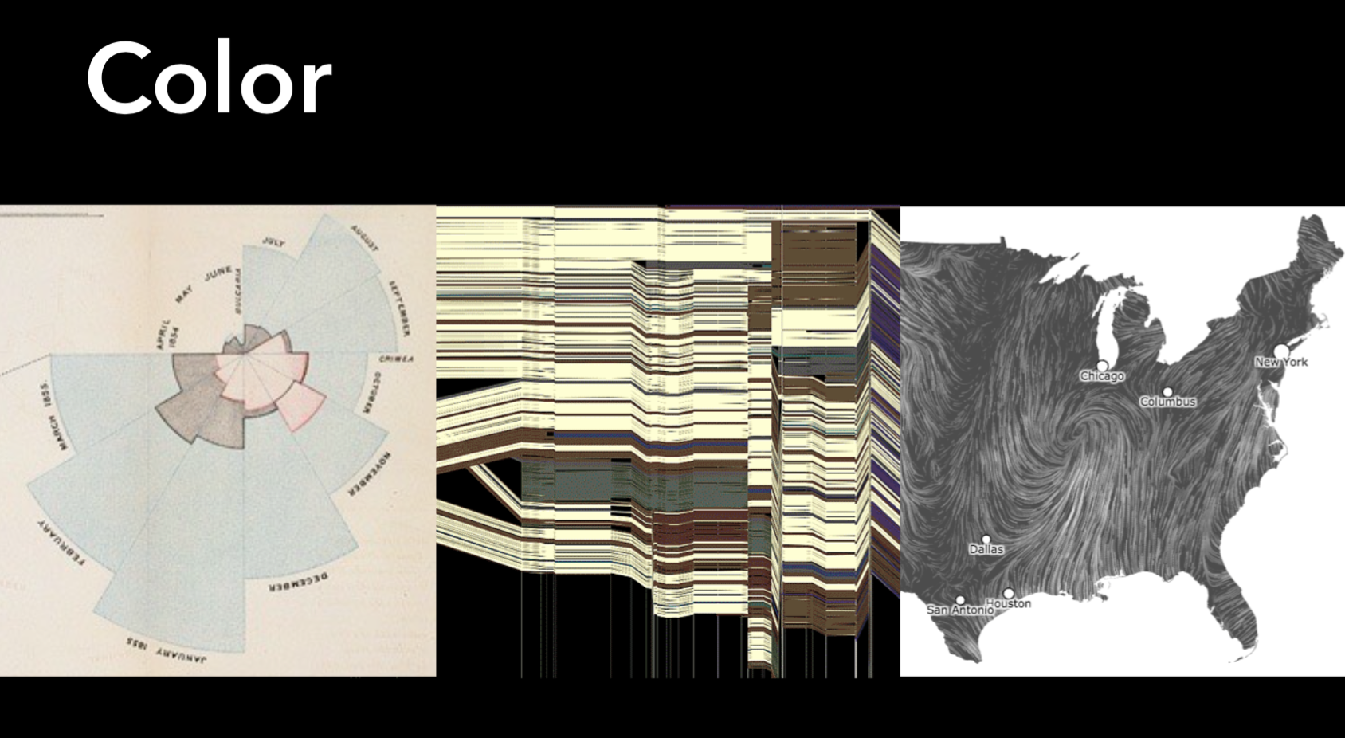

Slide 2
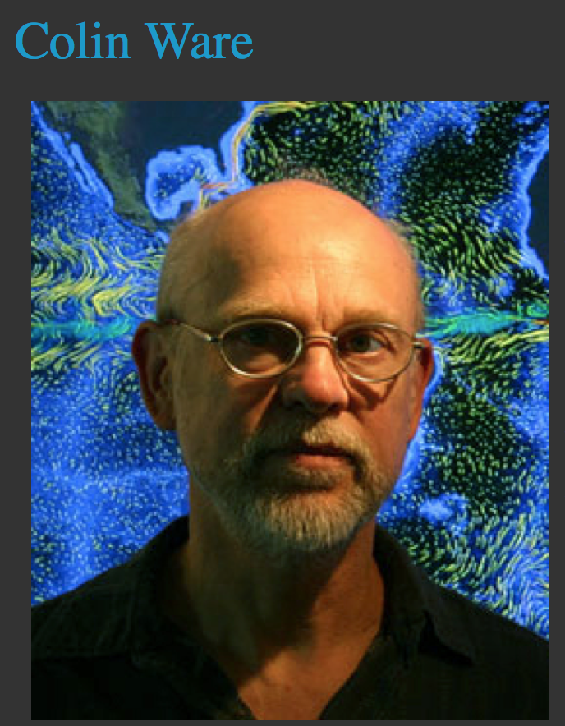
Notes:
Colin Ware is the Director of the Data Visualization Research Lab which is part of the Center for Coastal and Ocean Mapping at the University of New Hampshire. He is cross appointed between the Departments of Ocean Engineering and Computer Science. Ware specializes in advanced data visualization and has a special interest in applications of visualization to Ocean Mapping. He combines interests in both basic and applied research and he has advanced degrees in both computer science (MMath, Waterloo) and in the psychology of perception (PhD,Toronto).
Ware has published over 150 articles in scientific and technical journals and leading conference proceedings. Many of these articles relate to the use of color, texture, motion and 3D displays in information visualization. His approach is always to combine theory with practice and his publications range from rigorously scientific contributions to the Journal of Physiology and Vision Research to applications-oriented articles in ACM Transactions on Graphics and various visualization and human-computer Interaction Journals.

Slide 4
First, in brief summary…

Slide 5
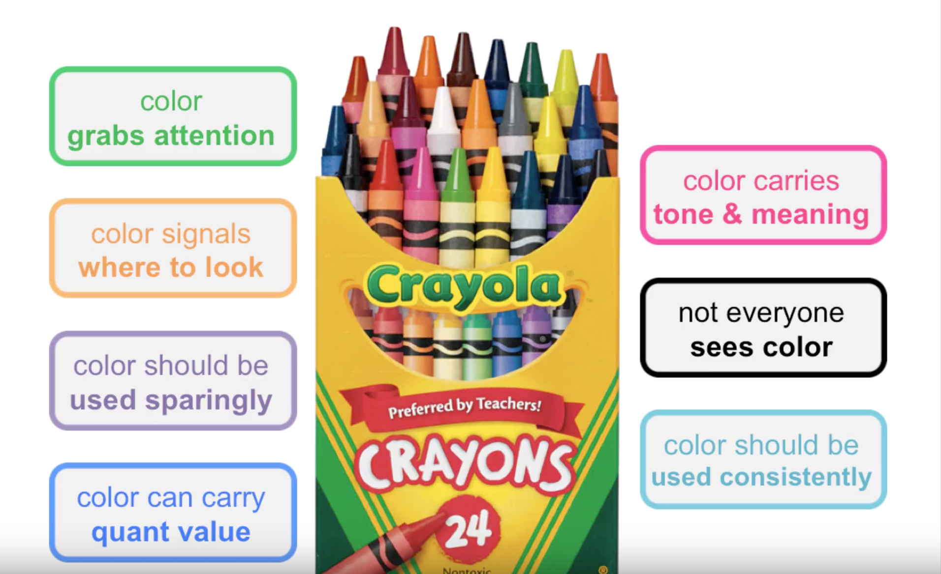

Slide 6
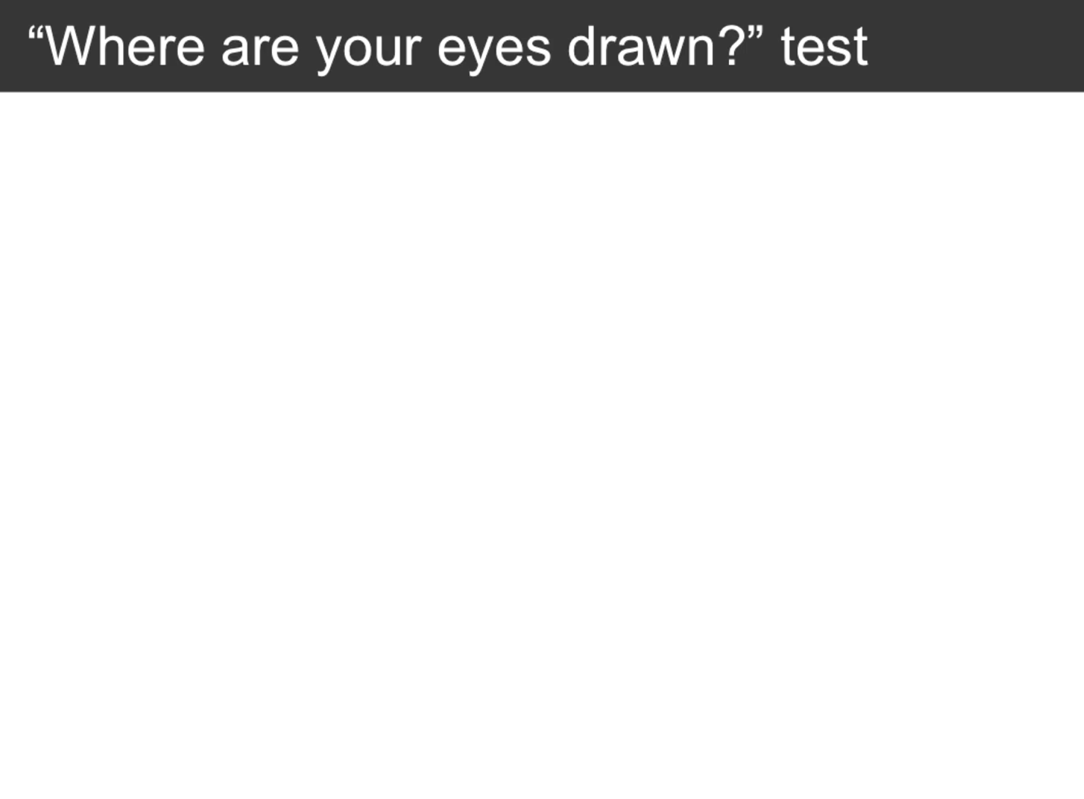

Slide 7
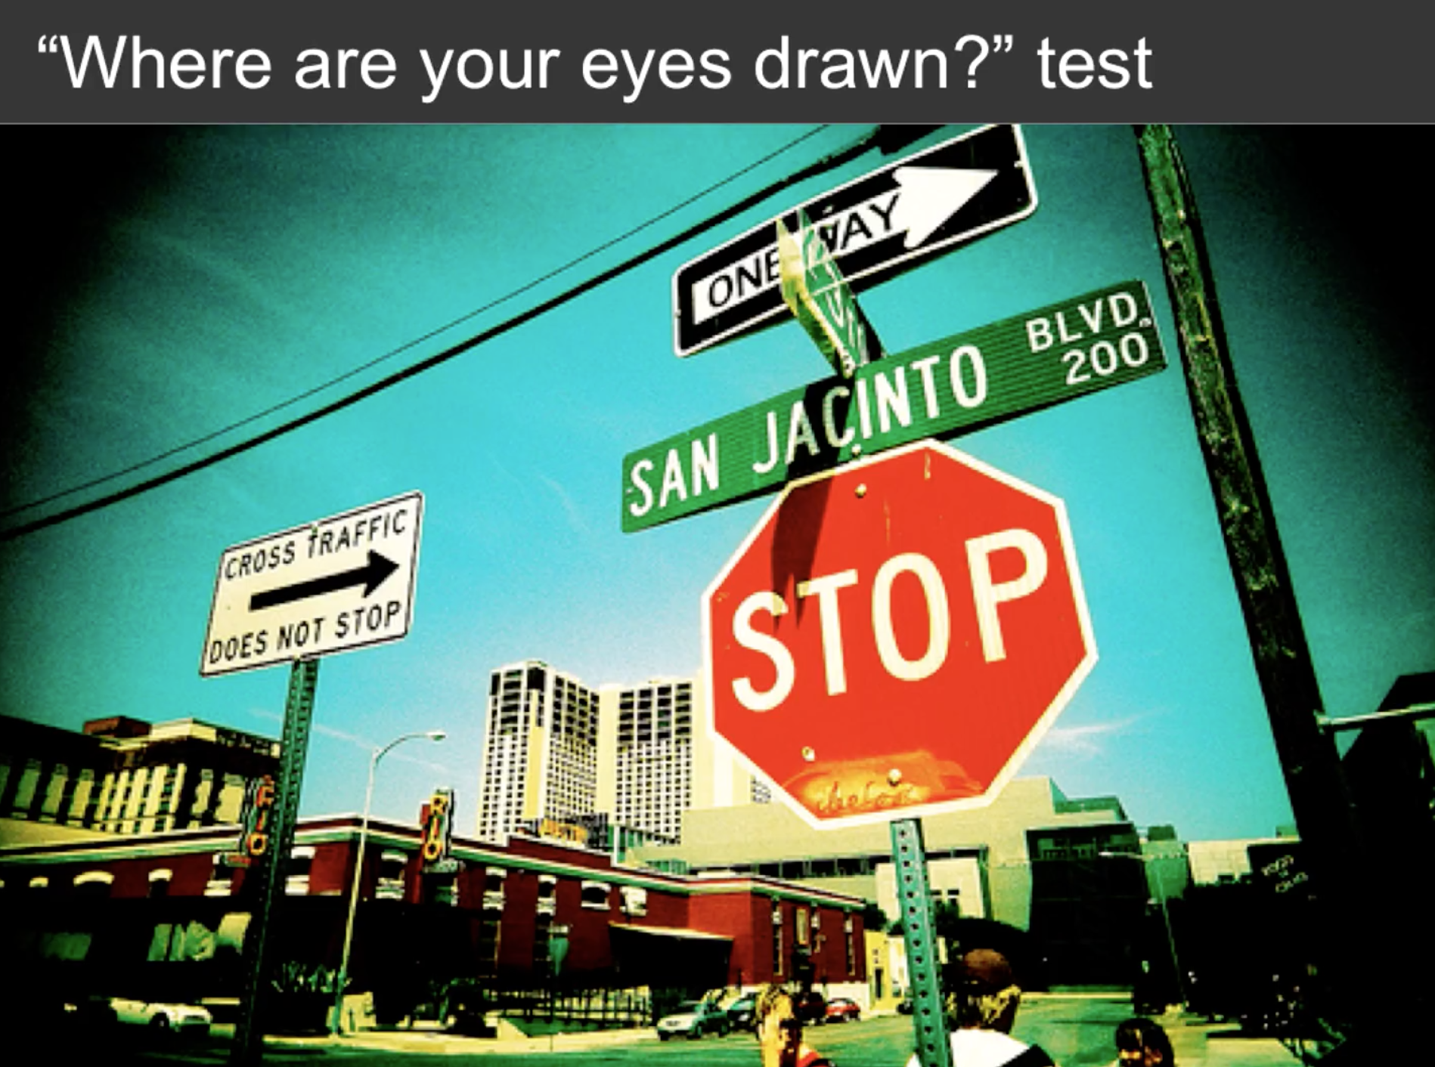
Notes:
Almost always the STOP sign

Slide 8

Notes:
Probably the sun but the plane is a quick second or vice versa

Slide 9
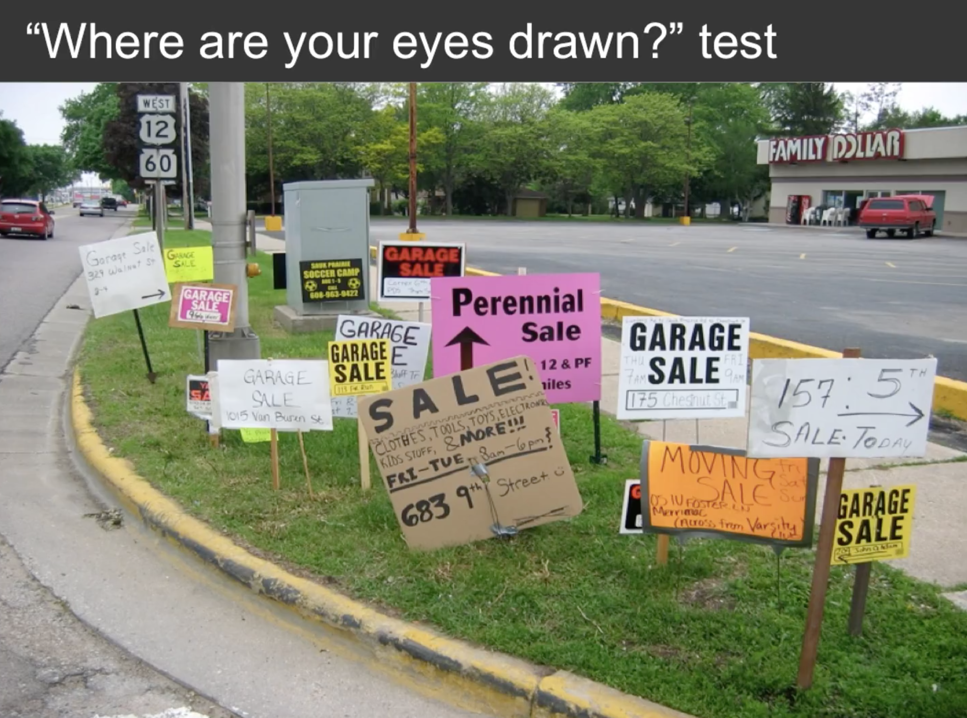
Notes:
Usually the pink Perennial Sale sign
It should be noted that the viewers eye is usually drawn to the top left corner first unless there is something competing with it like the pink sign (then the top cleft corner may be ignored)

Slide 10
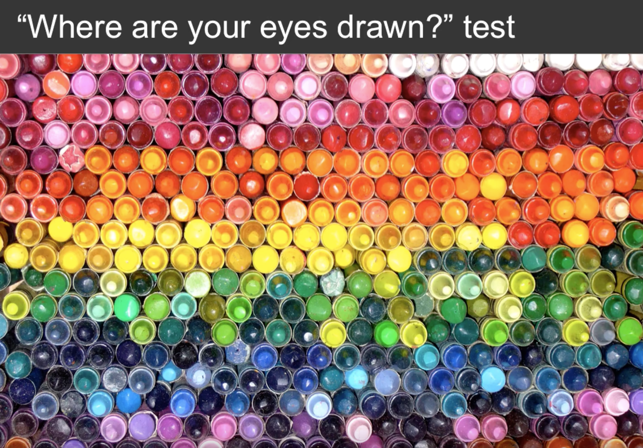
Notes:
The eye is drawn everywhere and nowhere

Slide 11
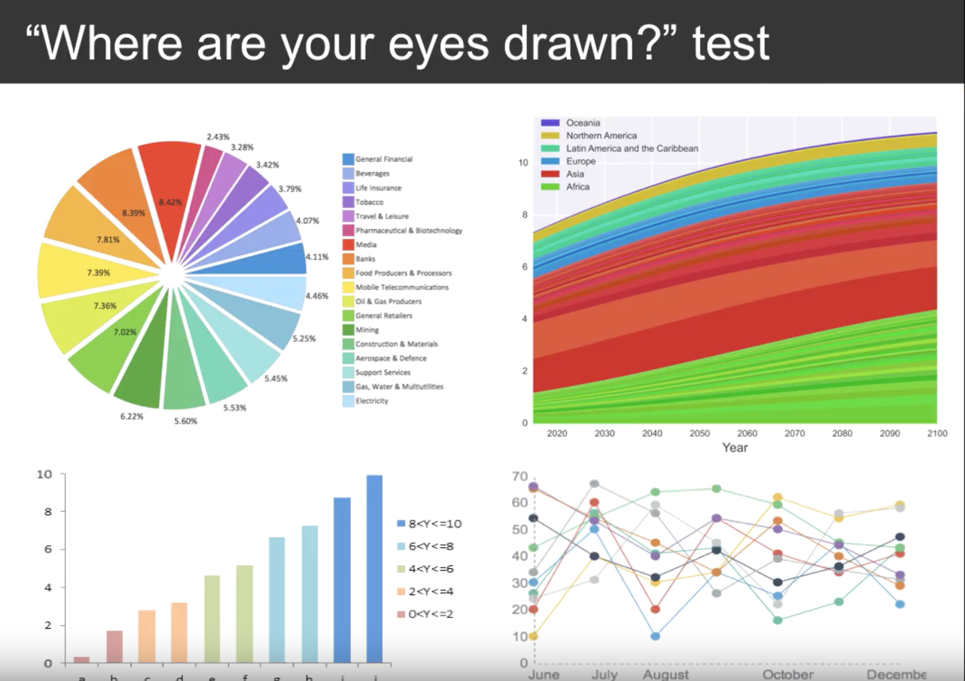
Notes:
That’s the downfall of the pretty graphs
That is precisely the problem with this beautiful graphic.
Color can be used more strategically than this

Slide 12
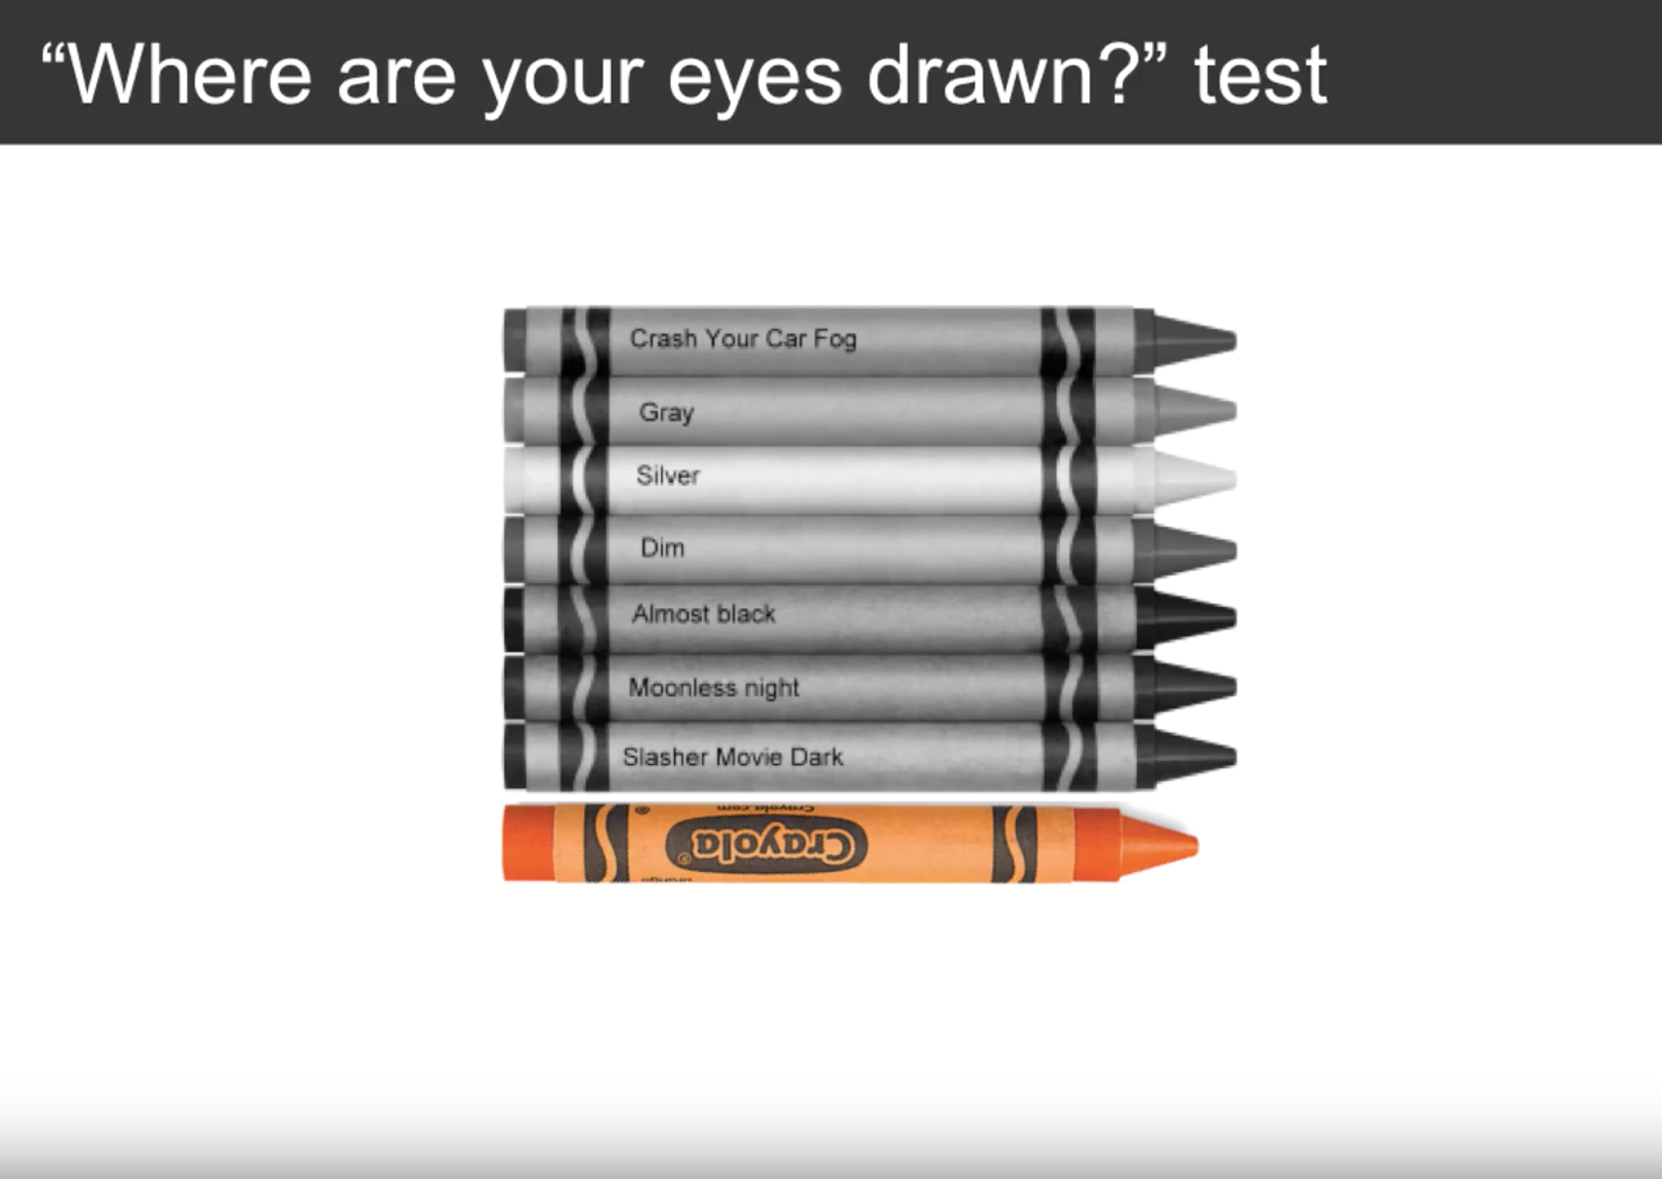
Notes:
Check out the difference between the previous graph and this one – it draws the eye. We can’t help but look at the orange crayon.

Slide 13
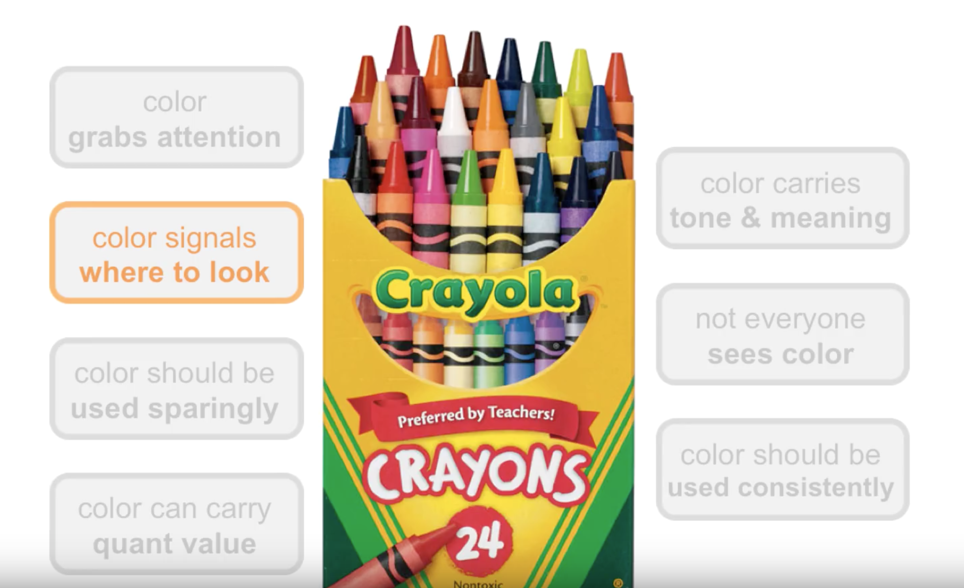

Slide 14
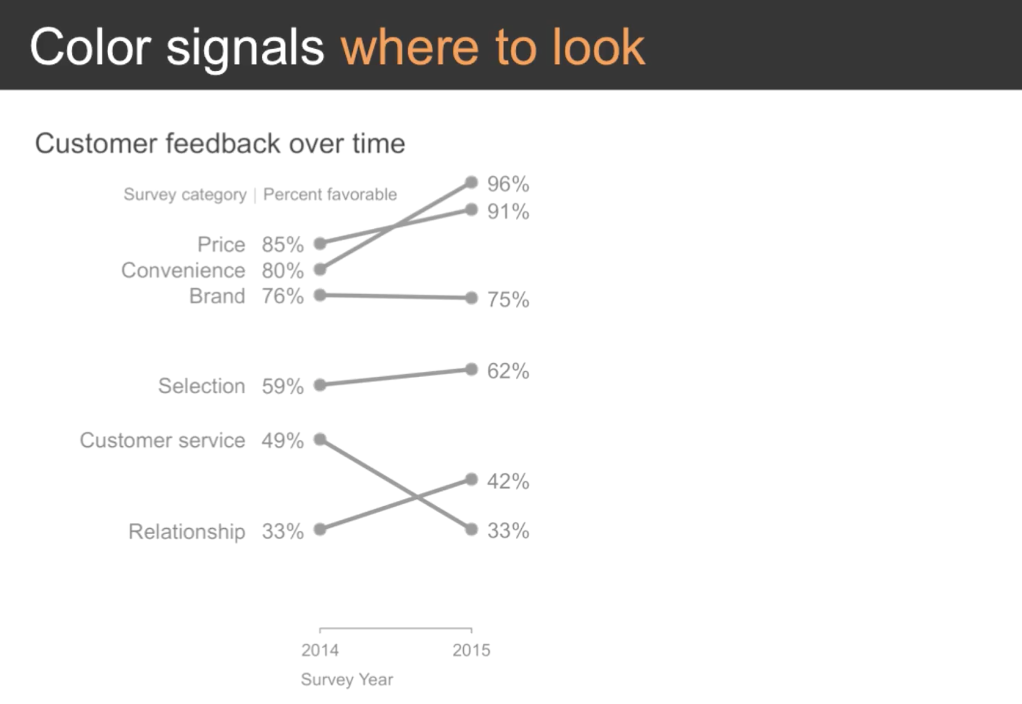

Slide 15
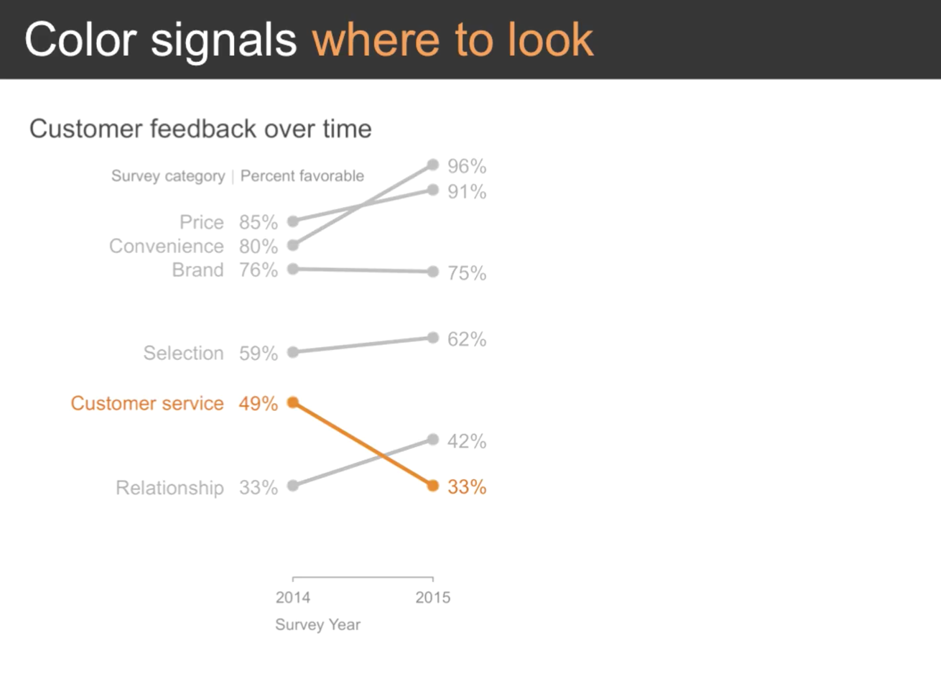

Slide 16
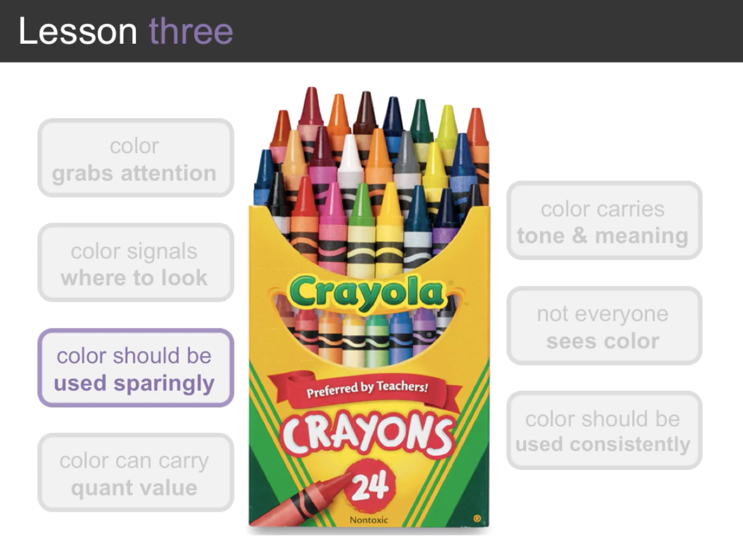

Slide 17
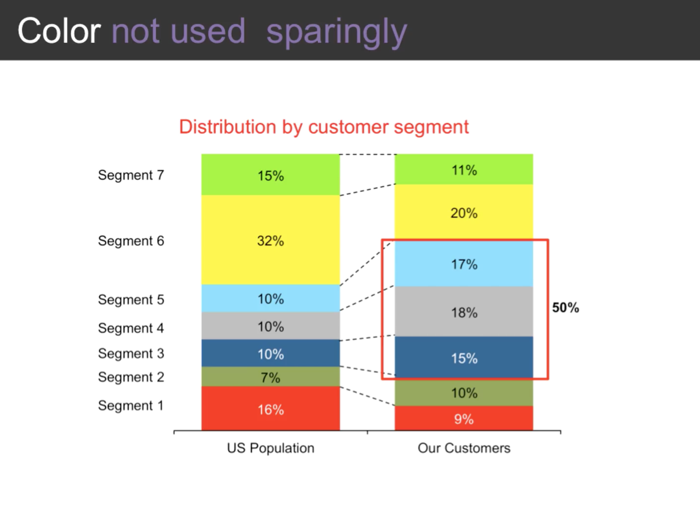

Slide 18
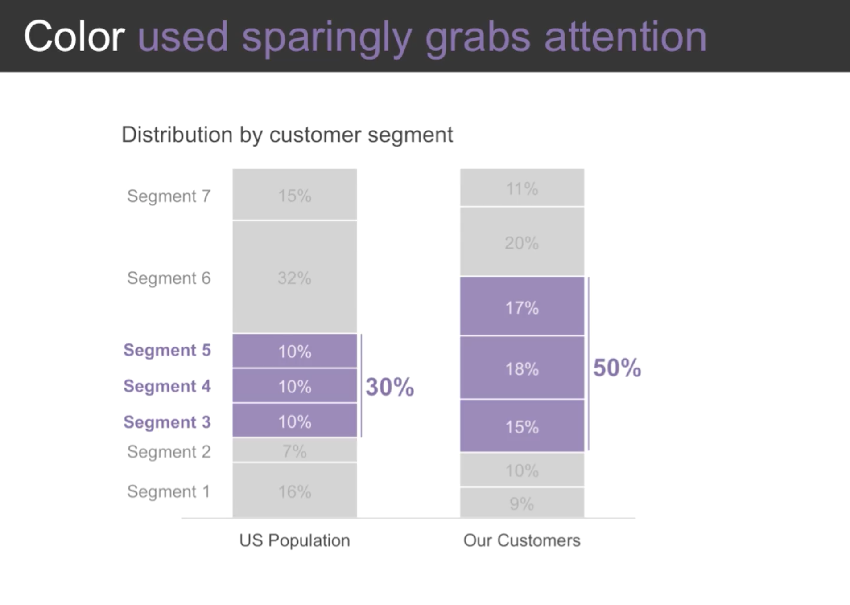

Slide 19
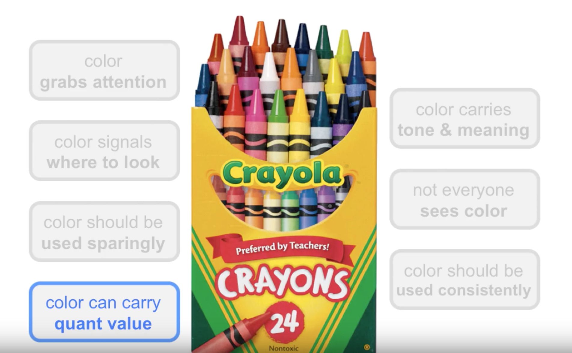

Slide 20
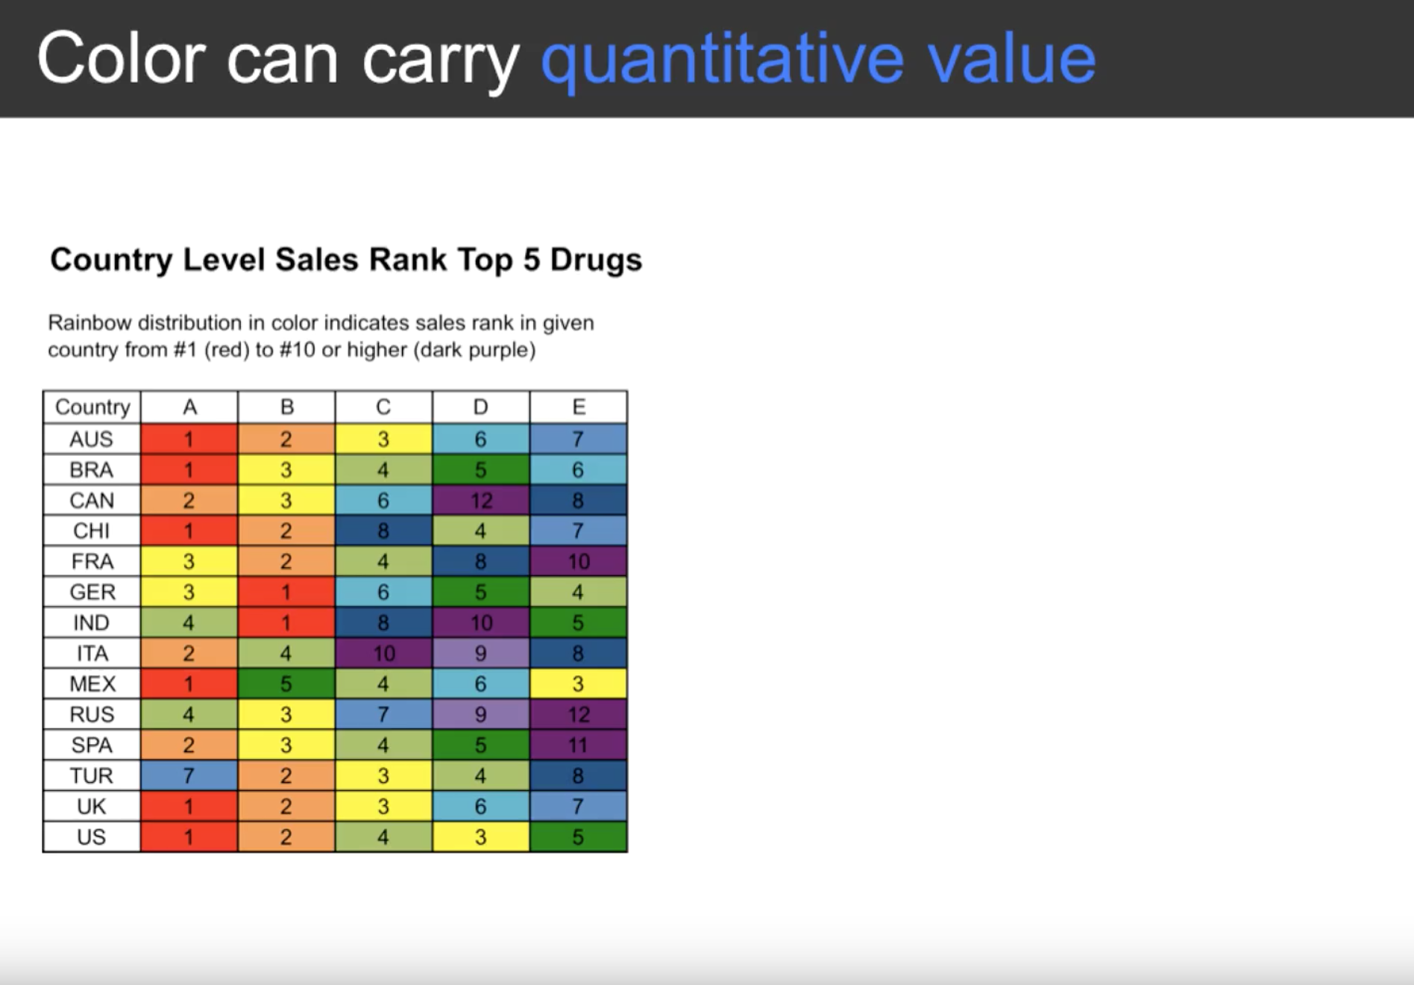
Notes:
Rainbow distribution in color – where is your eye drawn test – Red then purple but we do not want that here ….

Slide 21
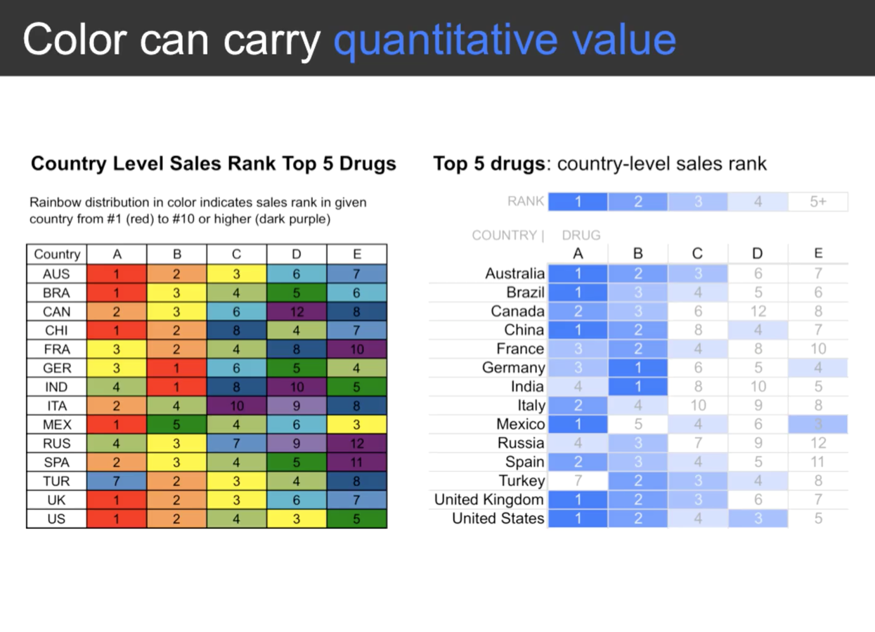
Notes:
A more thoughtful use of color

Slide 22
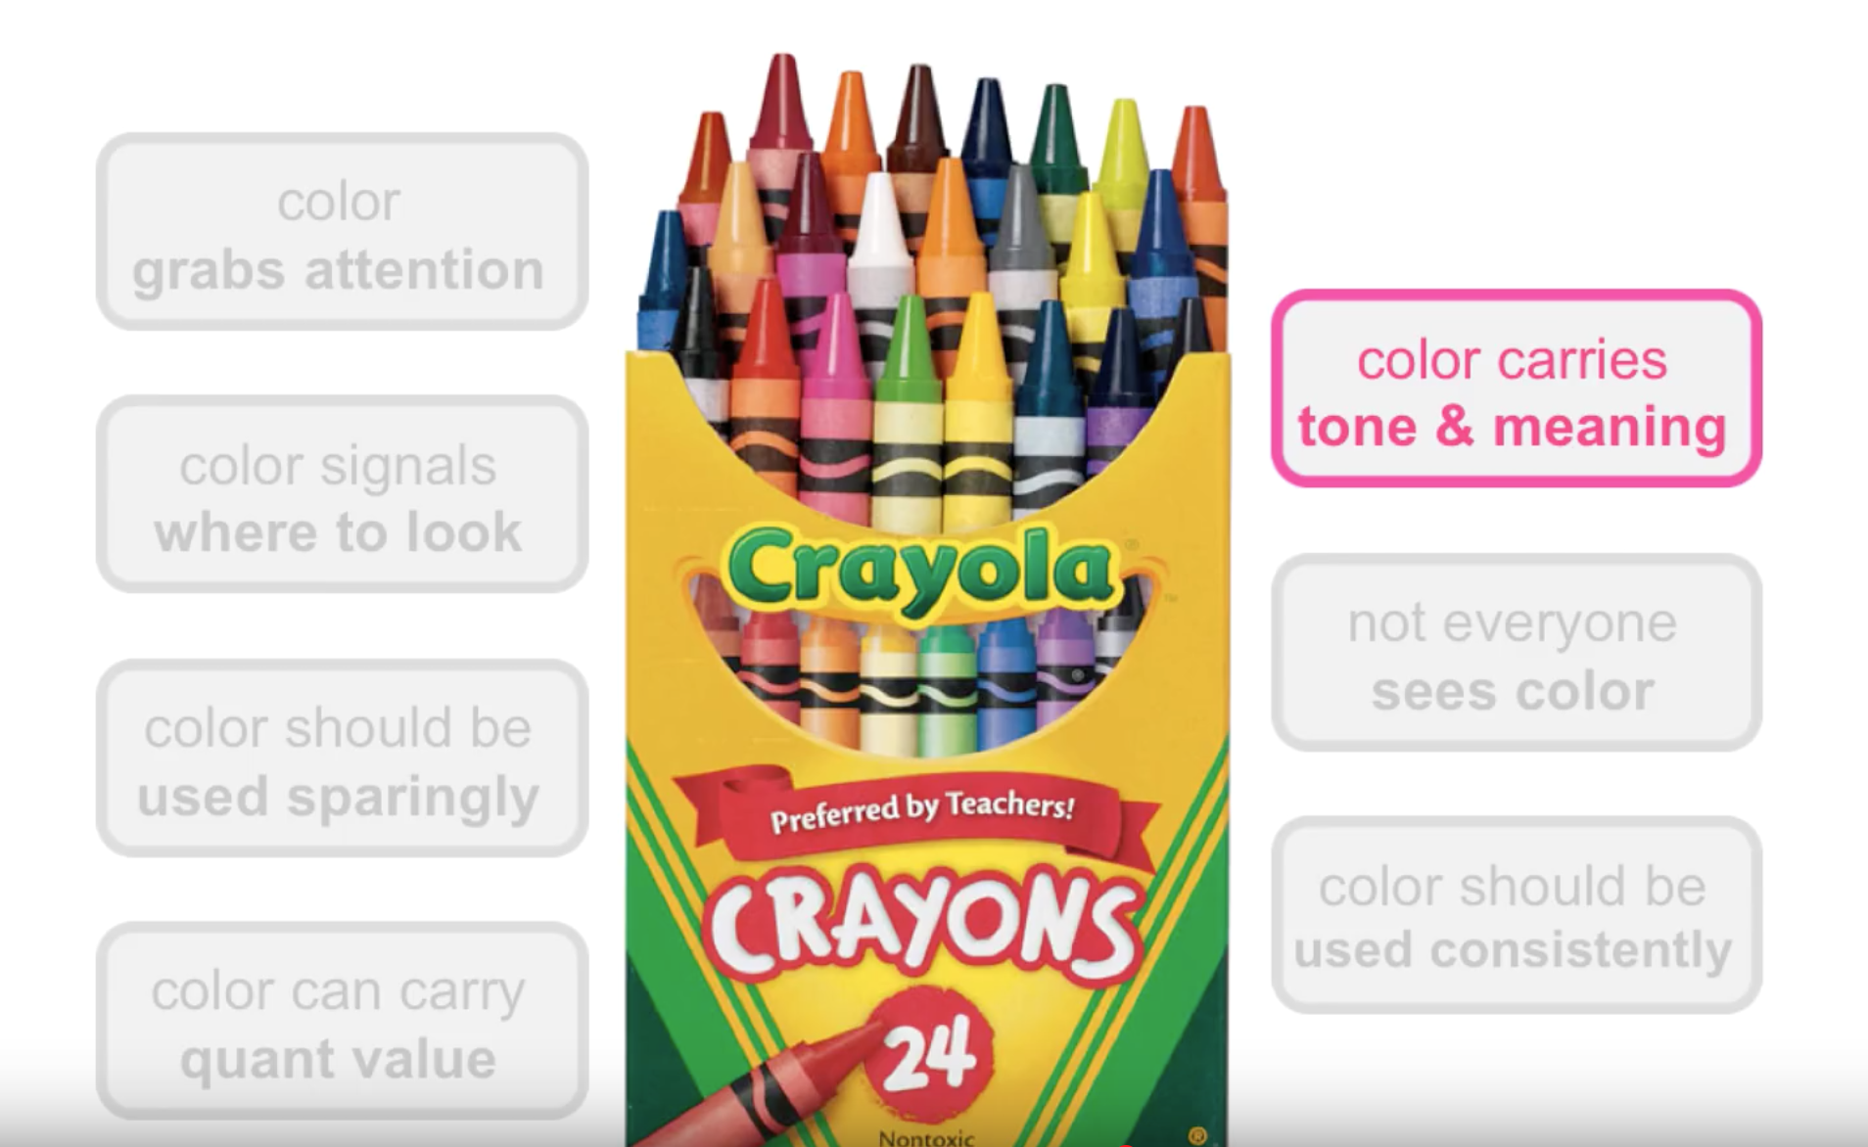

Slide 23
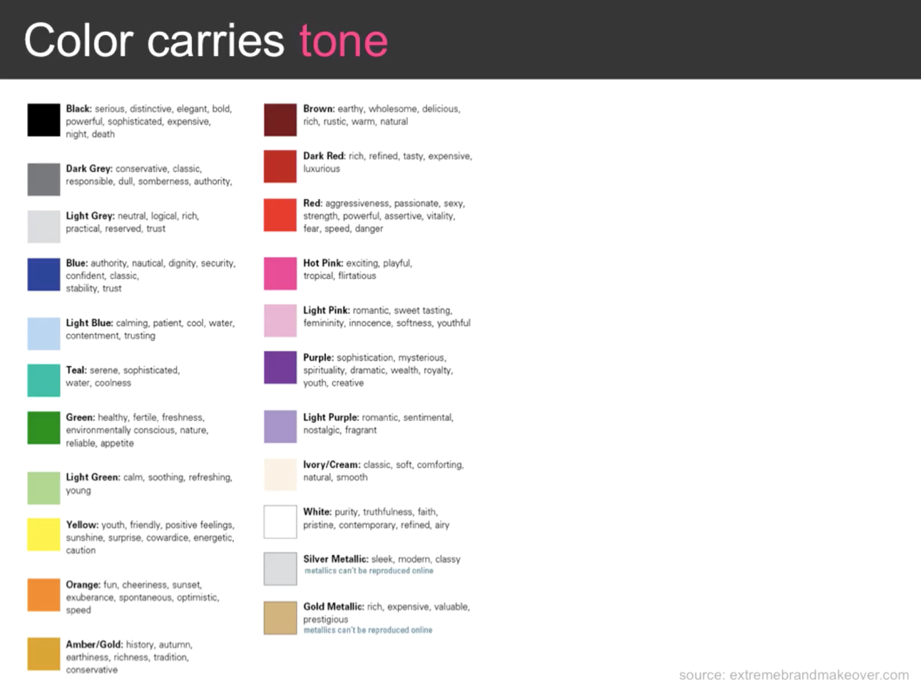
Notes:
Any google search will give you something like this….

Slide 24
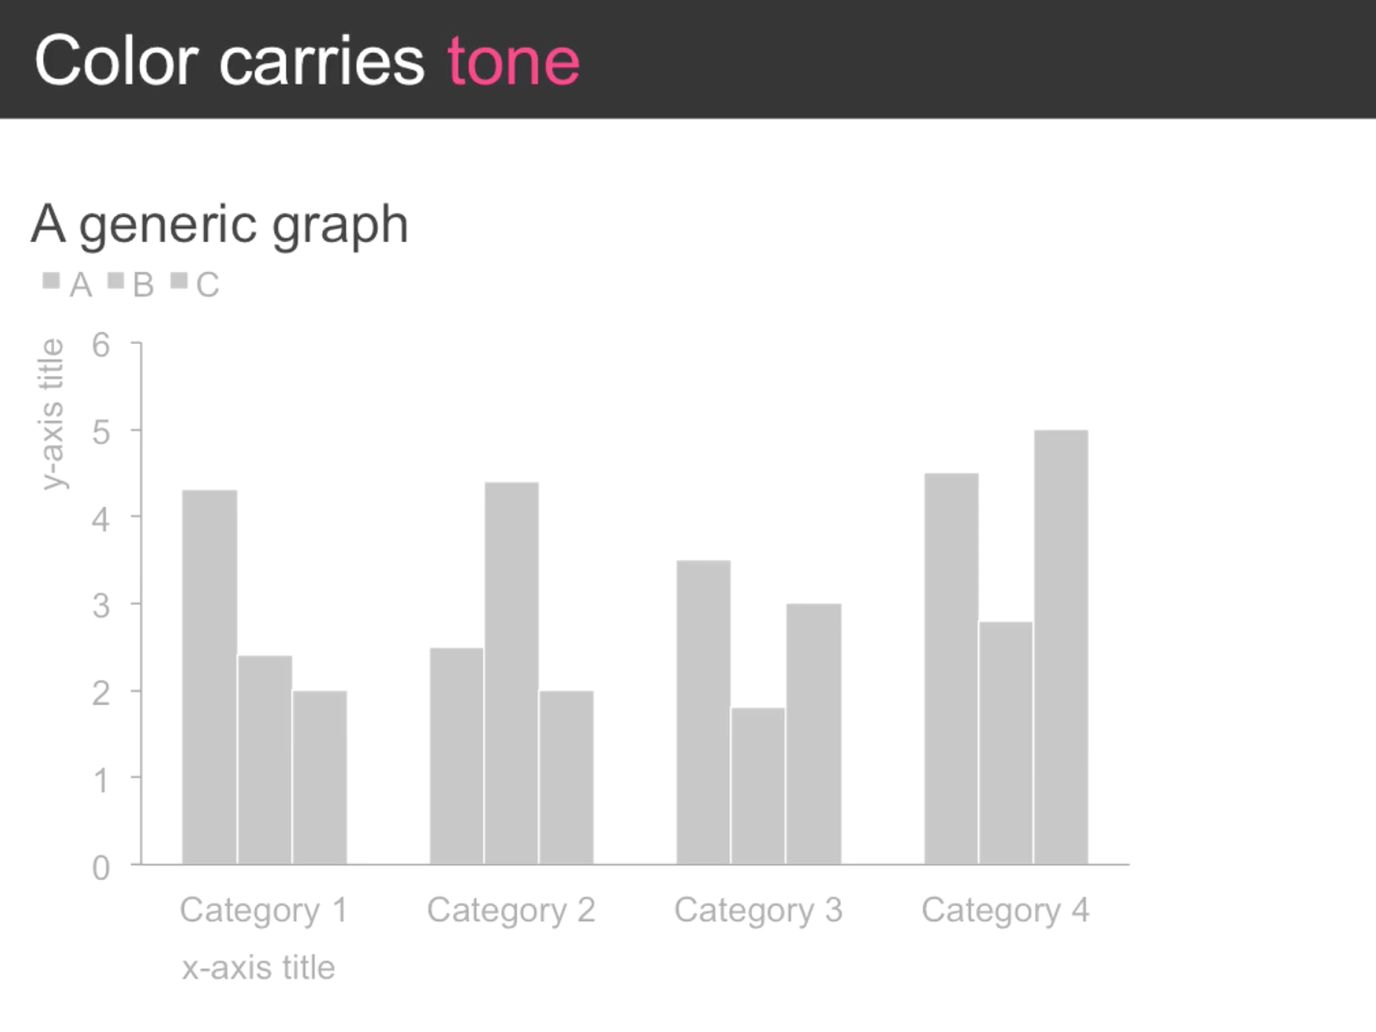

Slide 25
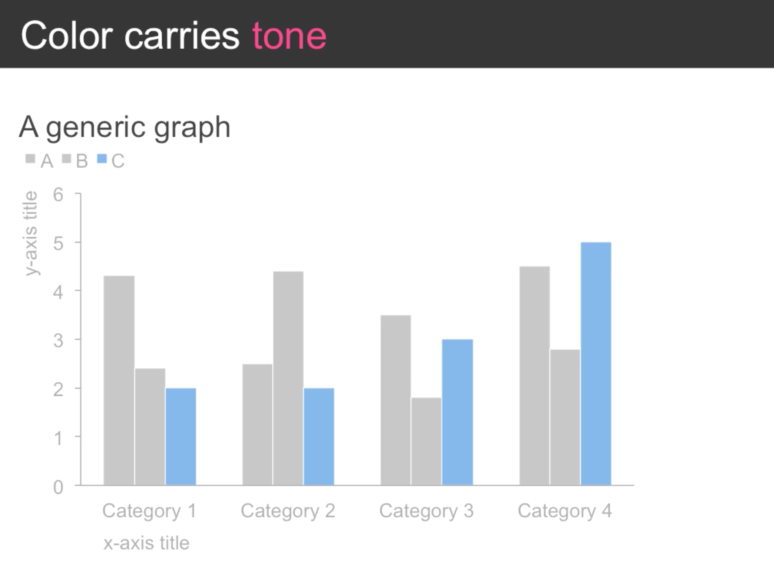
Notes:
Typical to use grey and light shades of blue

Slide 26
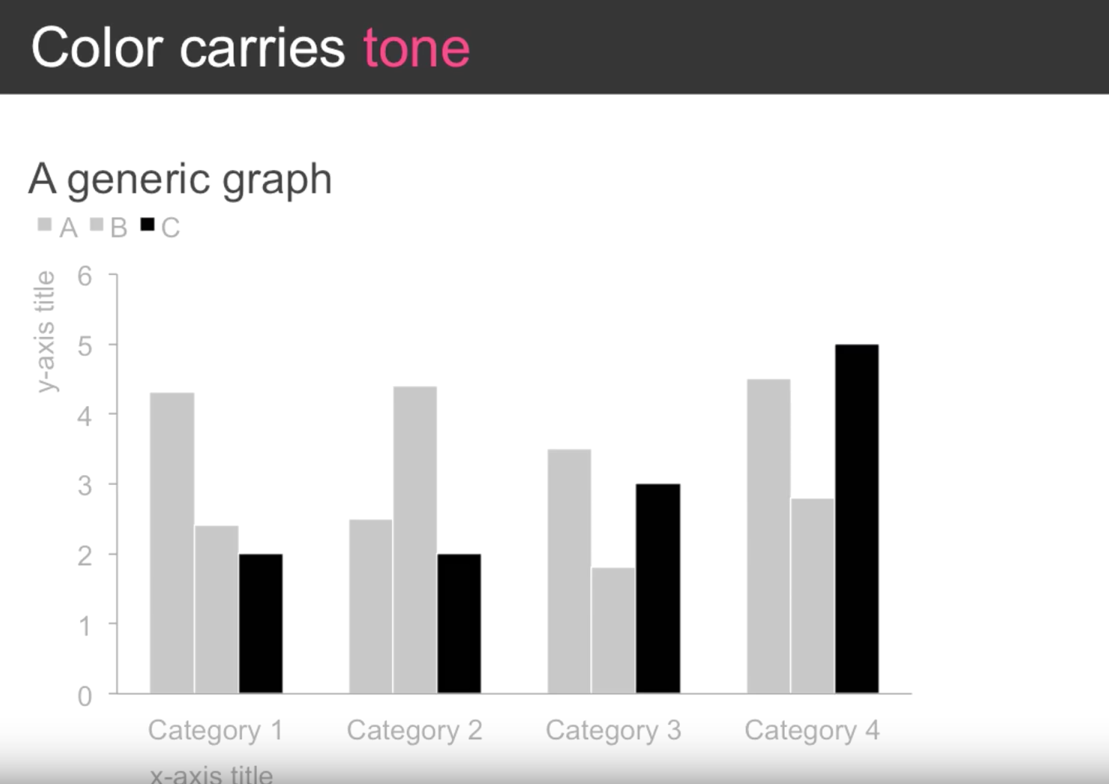
Notes:
For a more clinical look and feel use black…

Slide 27
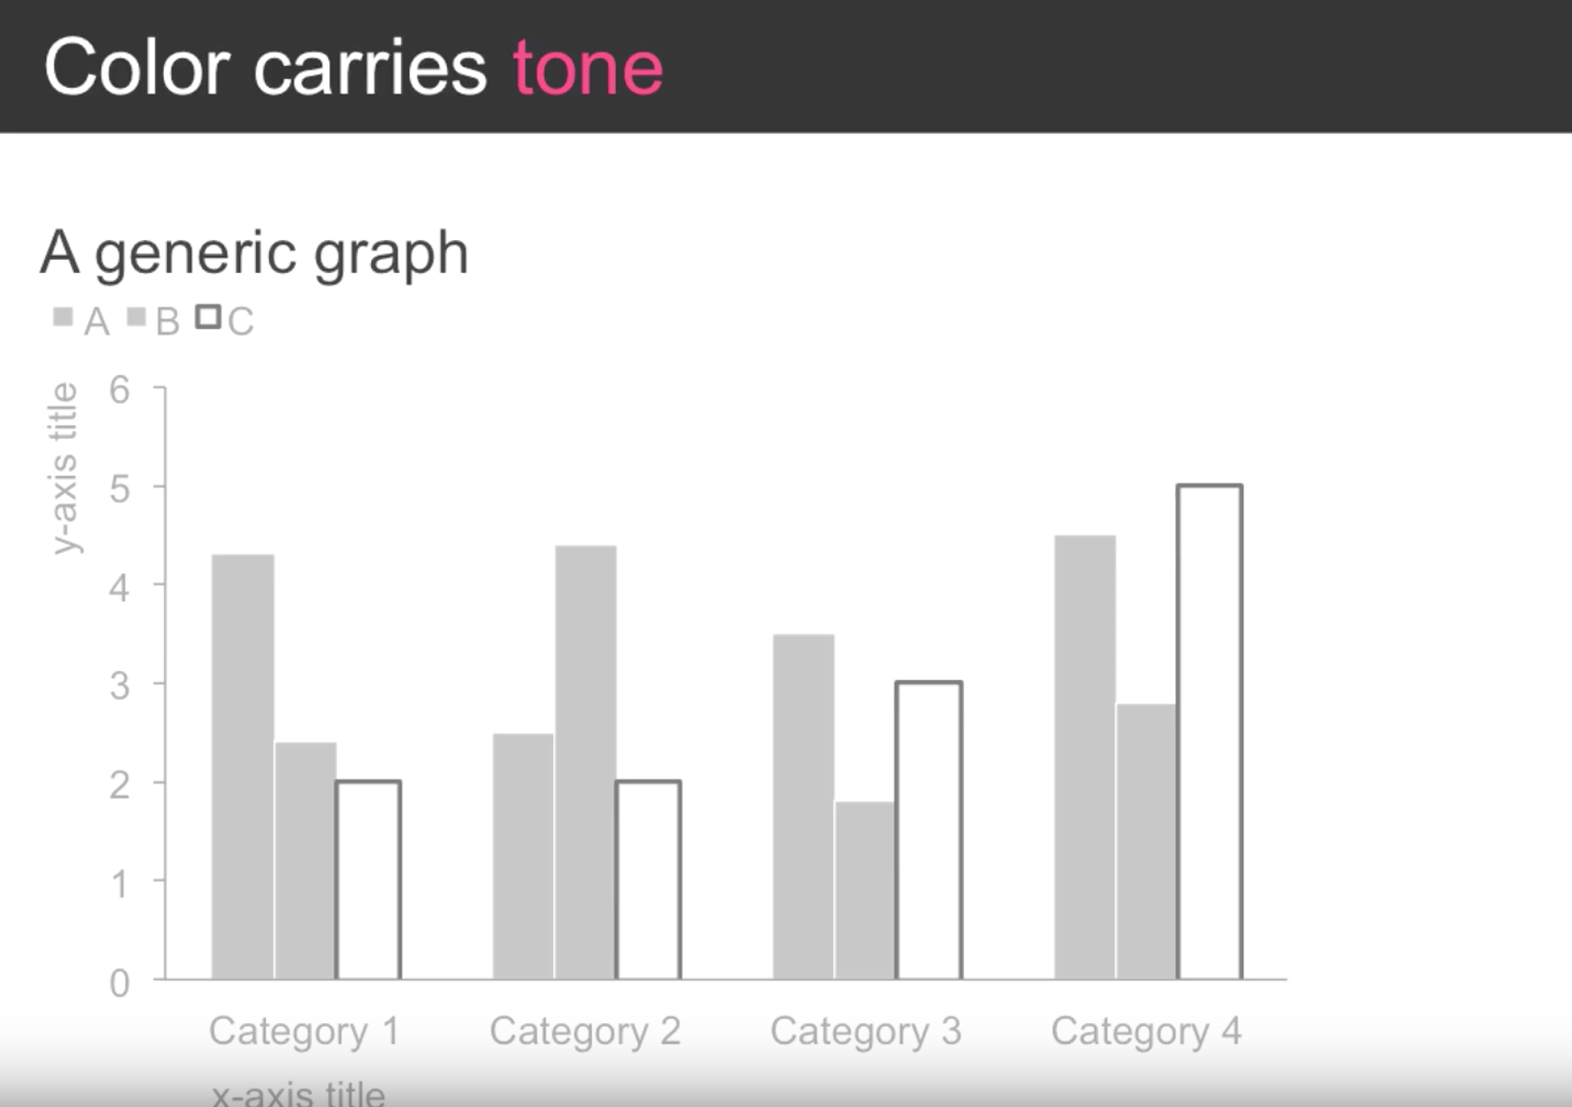
Notes:
Or perhaps use an outline for the assumption of opportunity?

Slide 28
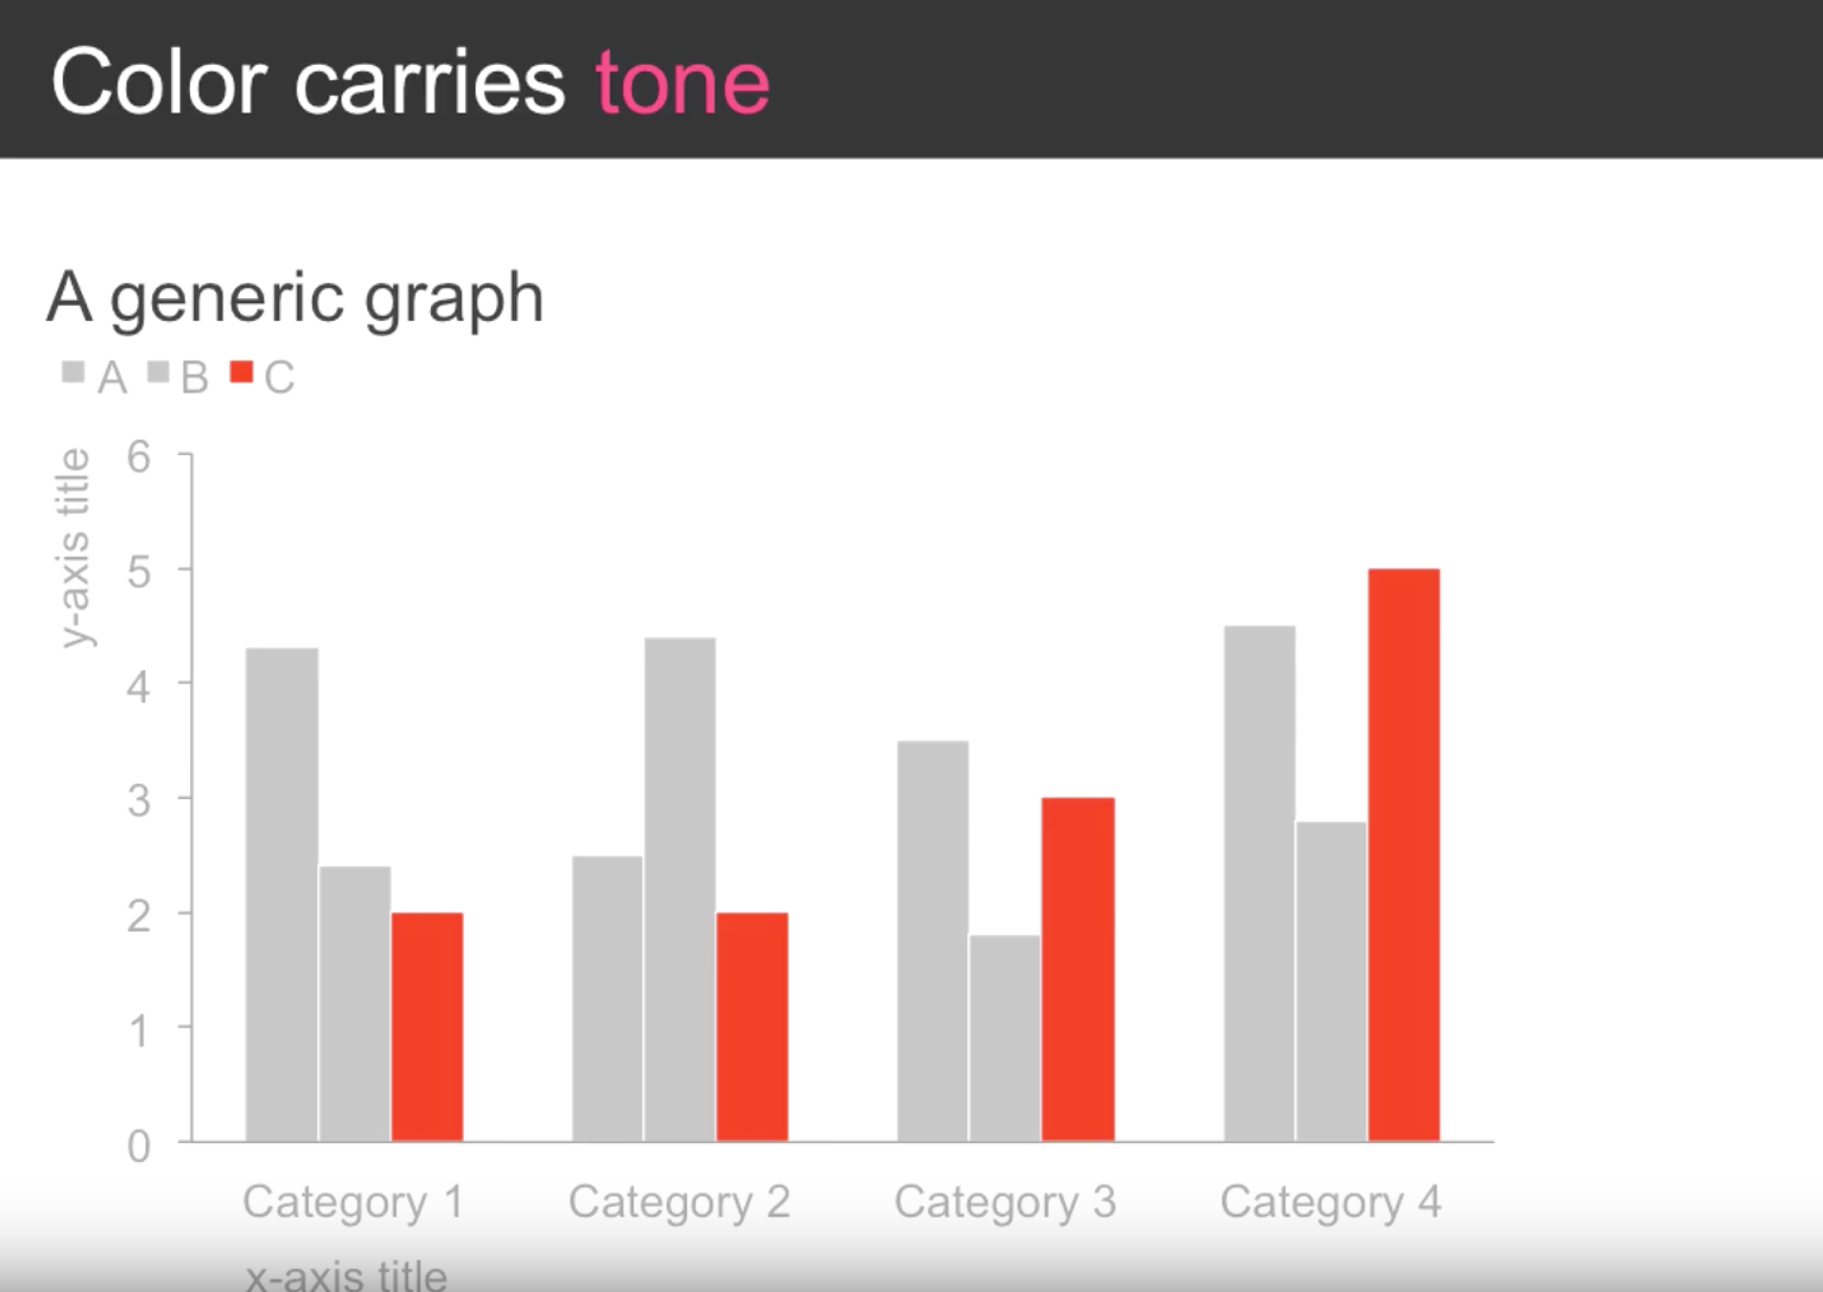
Notes:
Red trending upward feels like a negative thing….

Slide 29
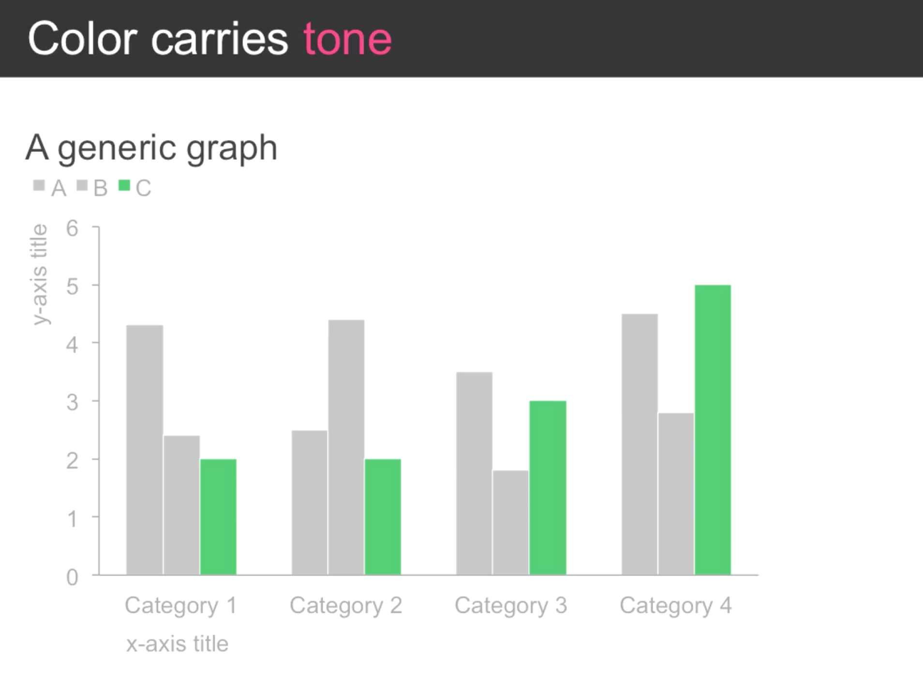
Notes:
Green trending upward feels like a positive thing….

Slide 30
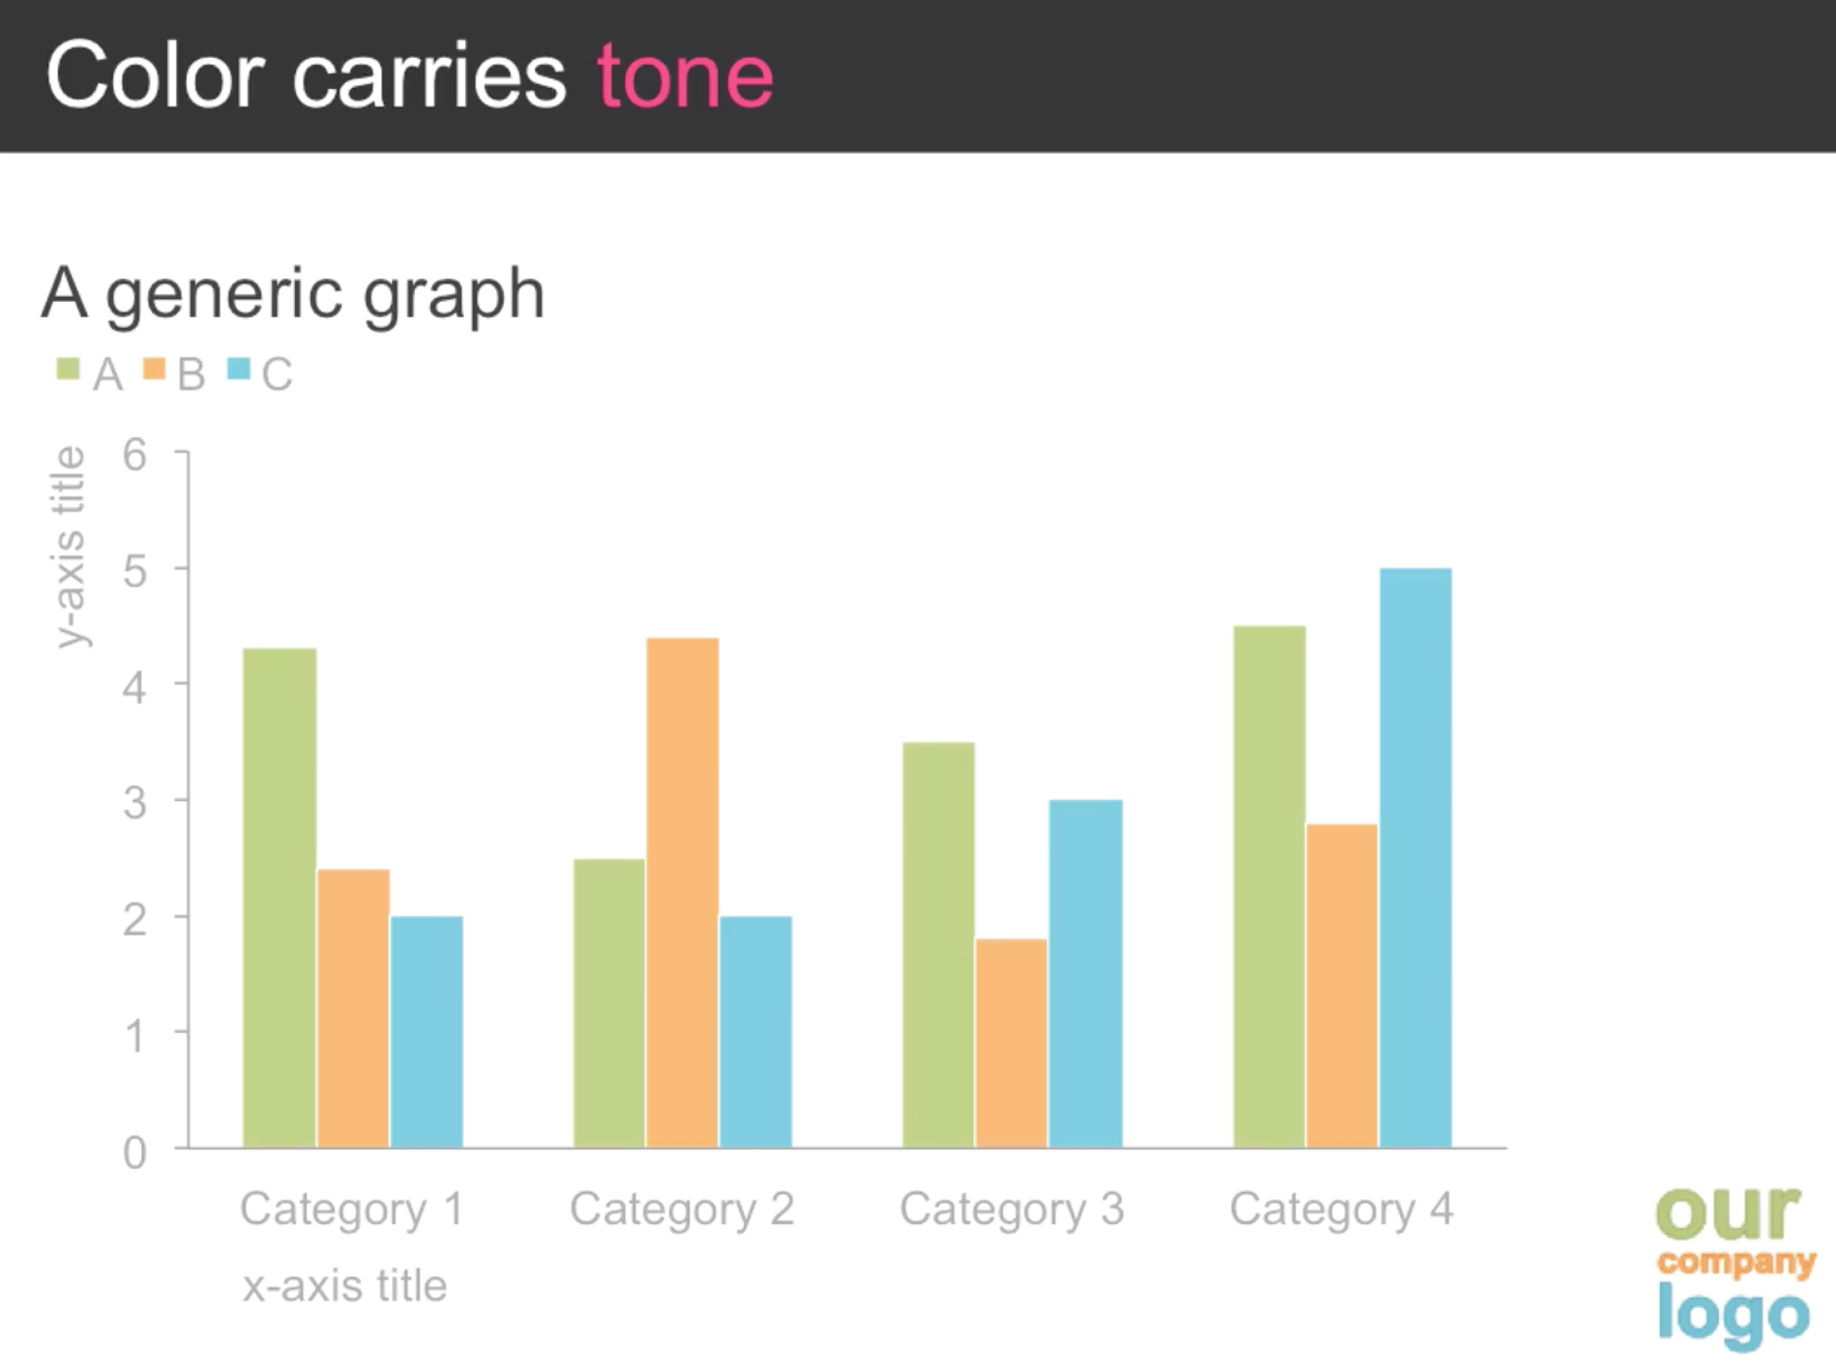
Notes:
You could use the company logo to set the tone, however, you do not necessarily need to use all the colors (use color sparingly)

Slide 31
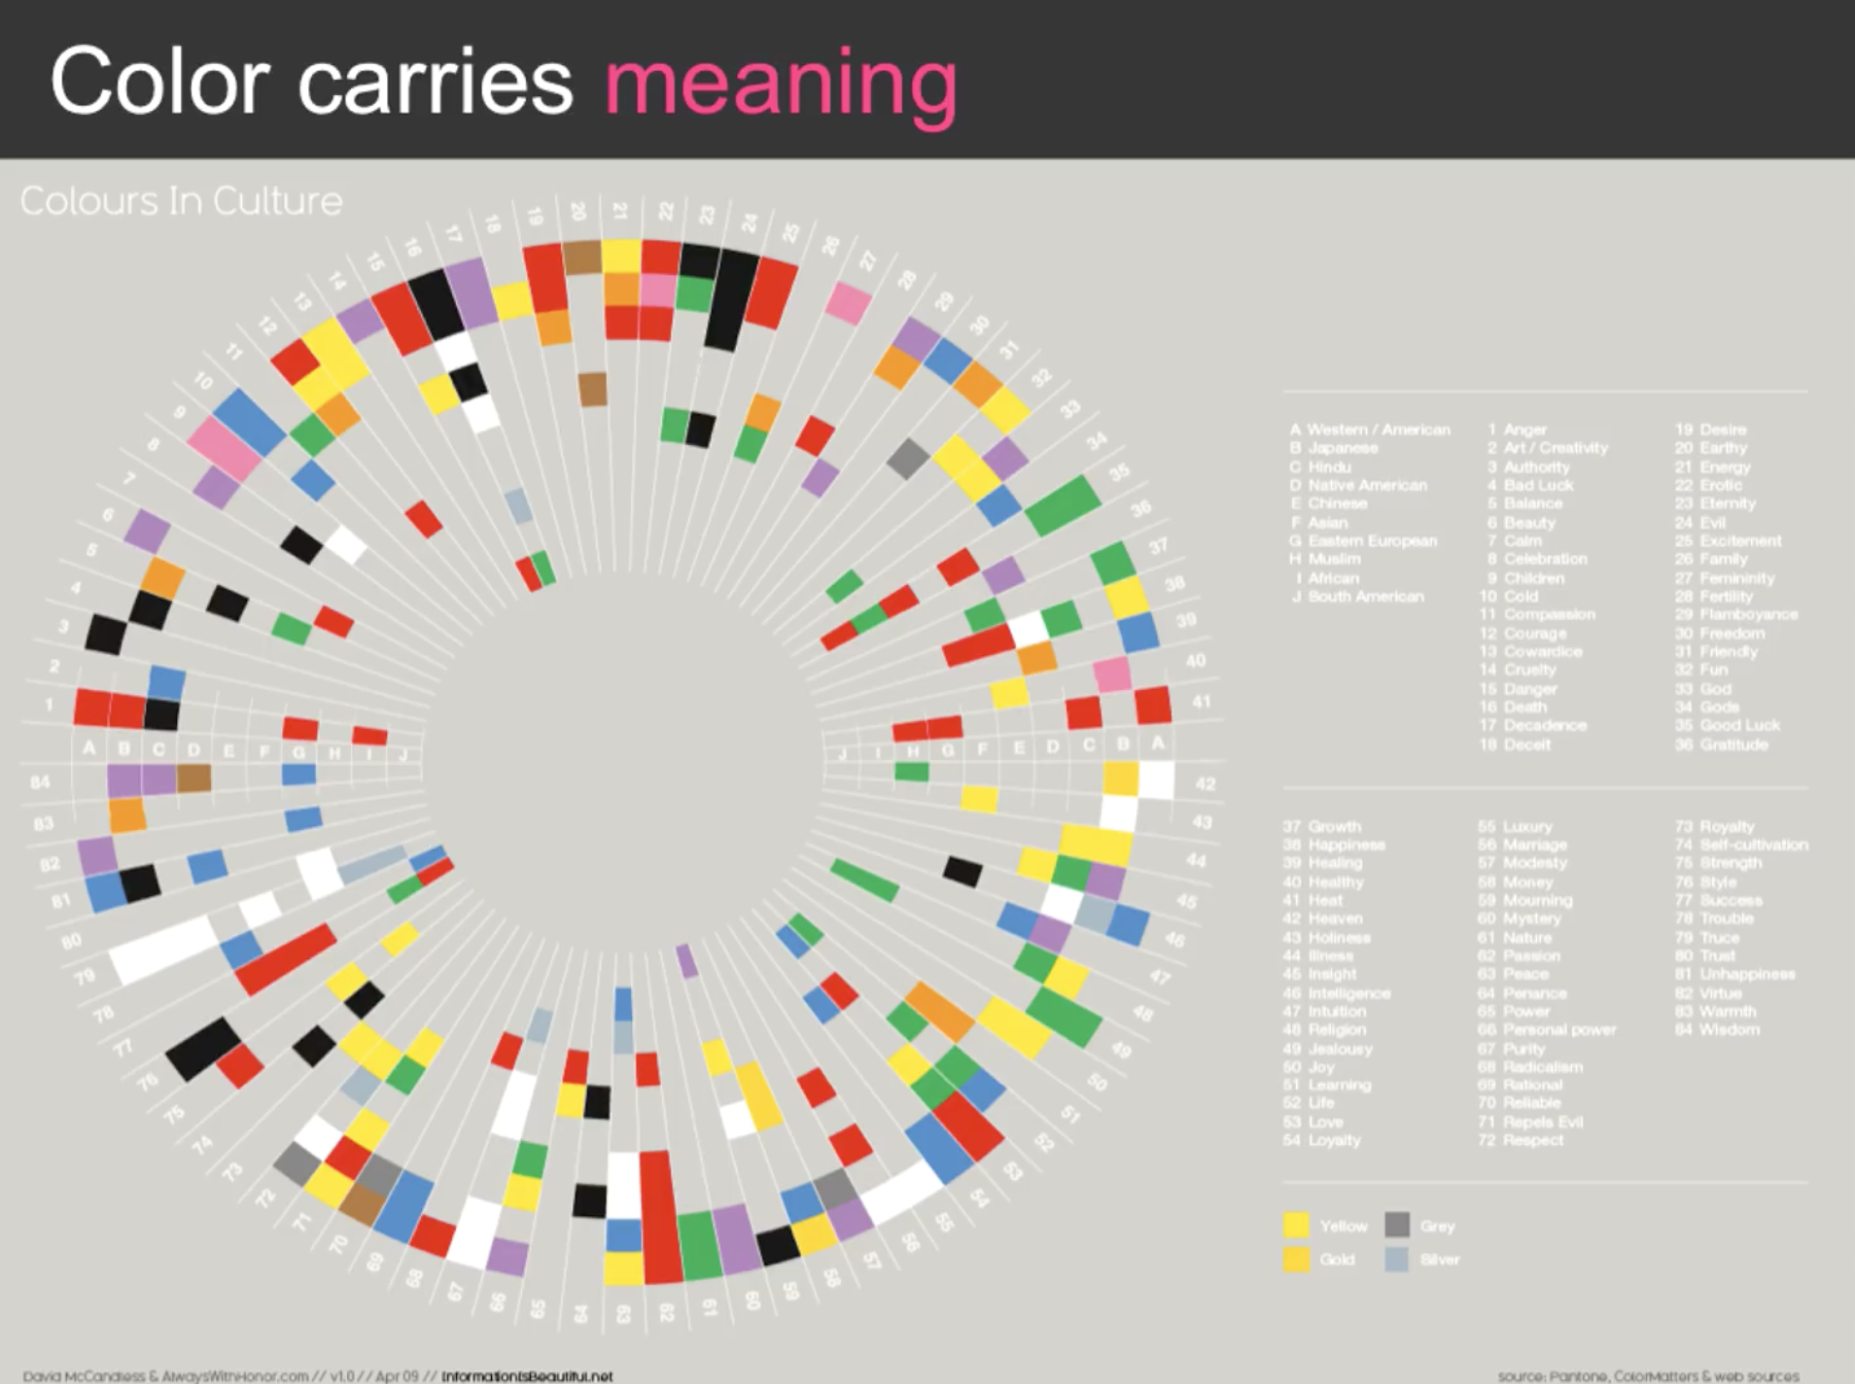
Notes:
Be aware of the tone and meaning color can have…

Slide 32
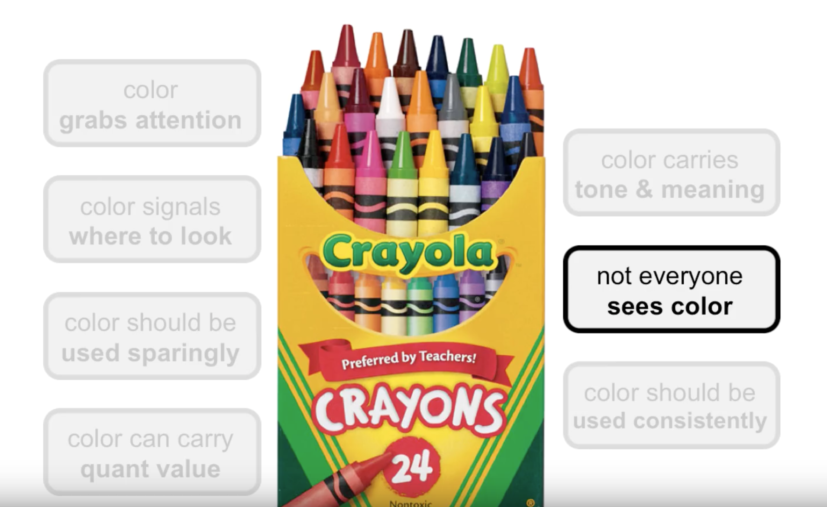

Slide 33
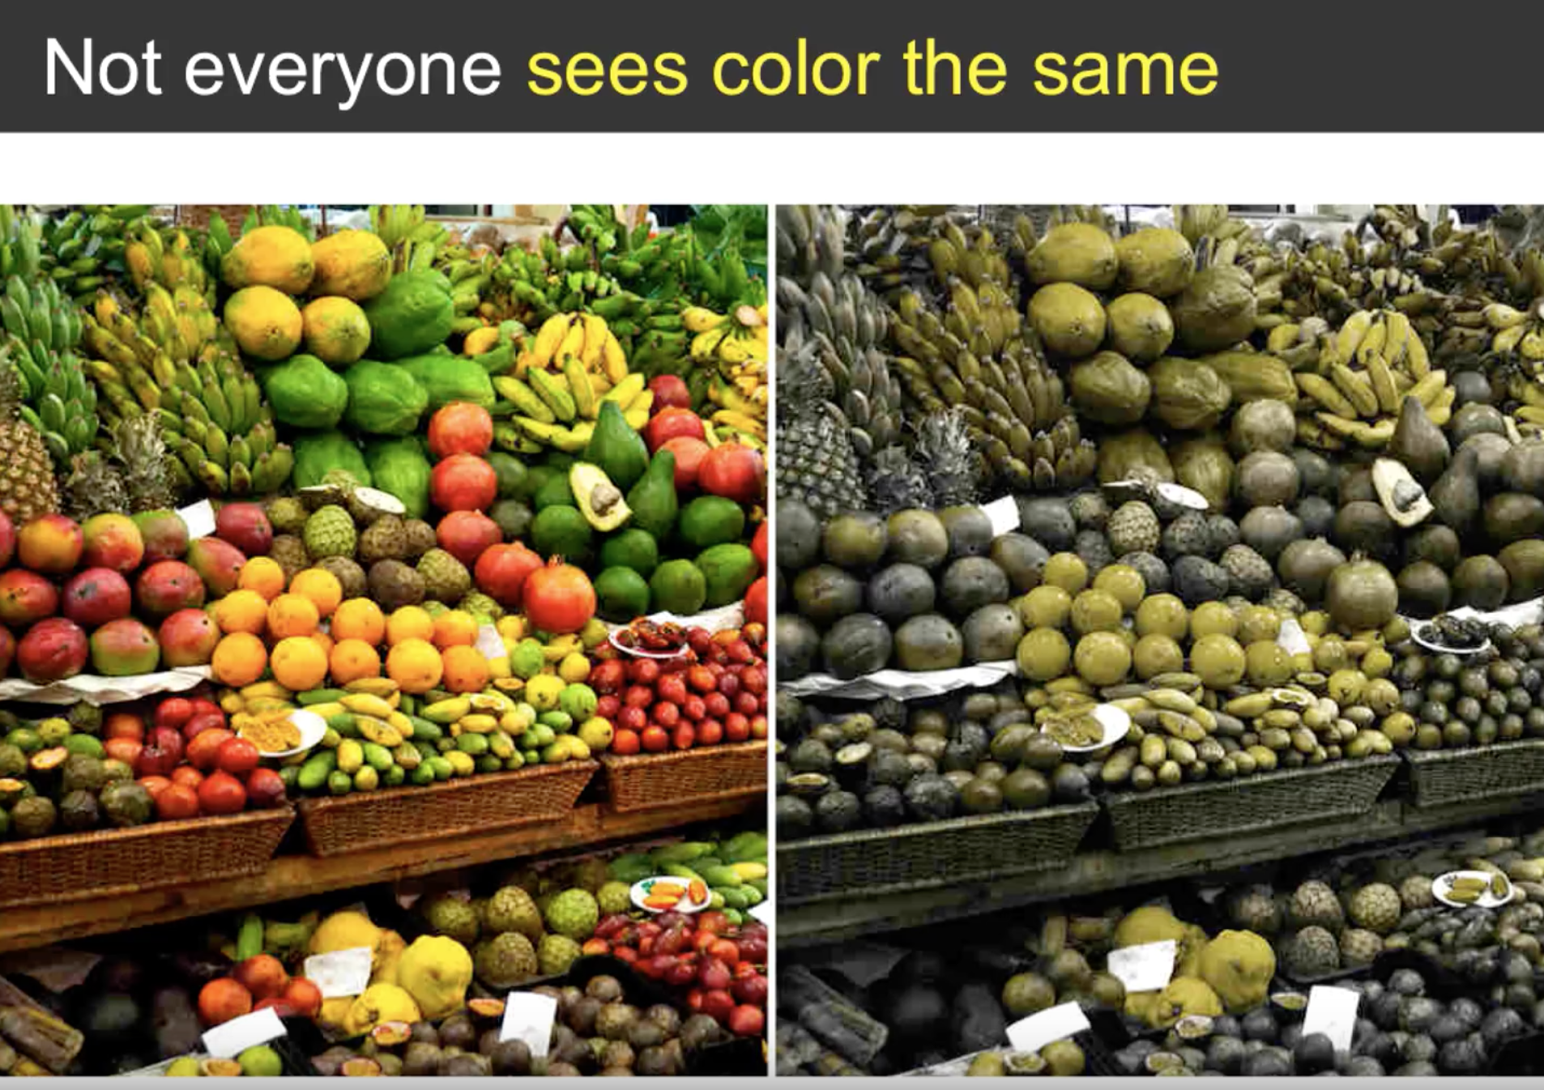
Notes:
8% of men and .5% of women are color blind, avoid red-green and yellow-blue touching. If you need to have these colors then make sure you have additional encodings such as bold or italics…

Slide 34
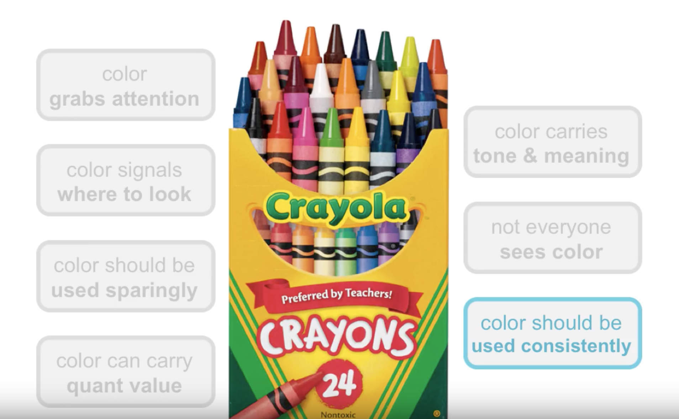

Slide 35
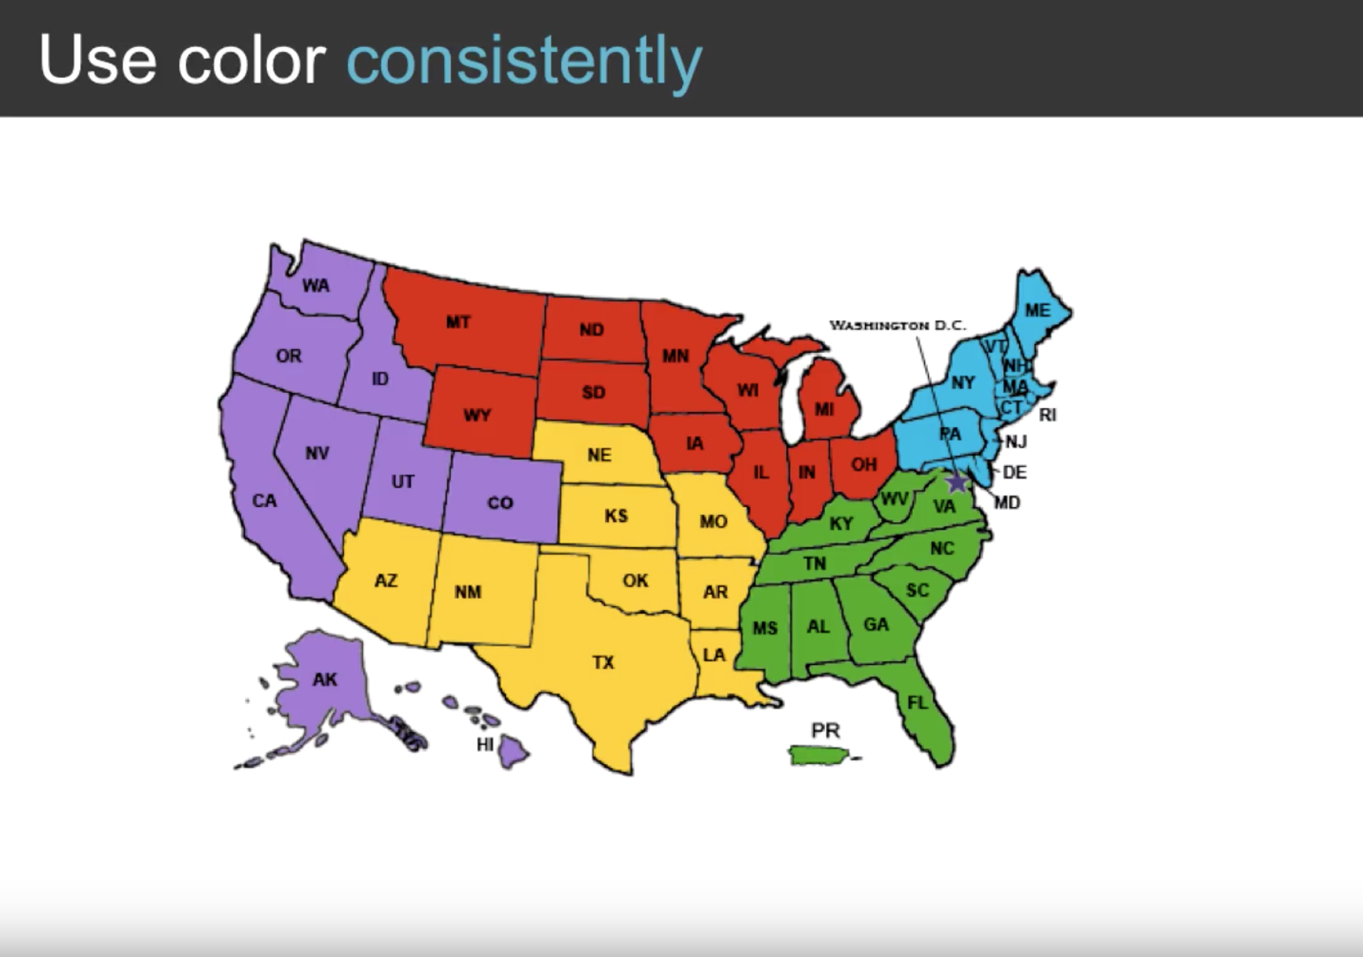
Notes:
If these colors are used to represent 5 regions of sales, make sure to use these same colors throughout the document and visualizations.

Slide 36
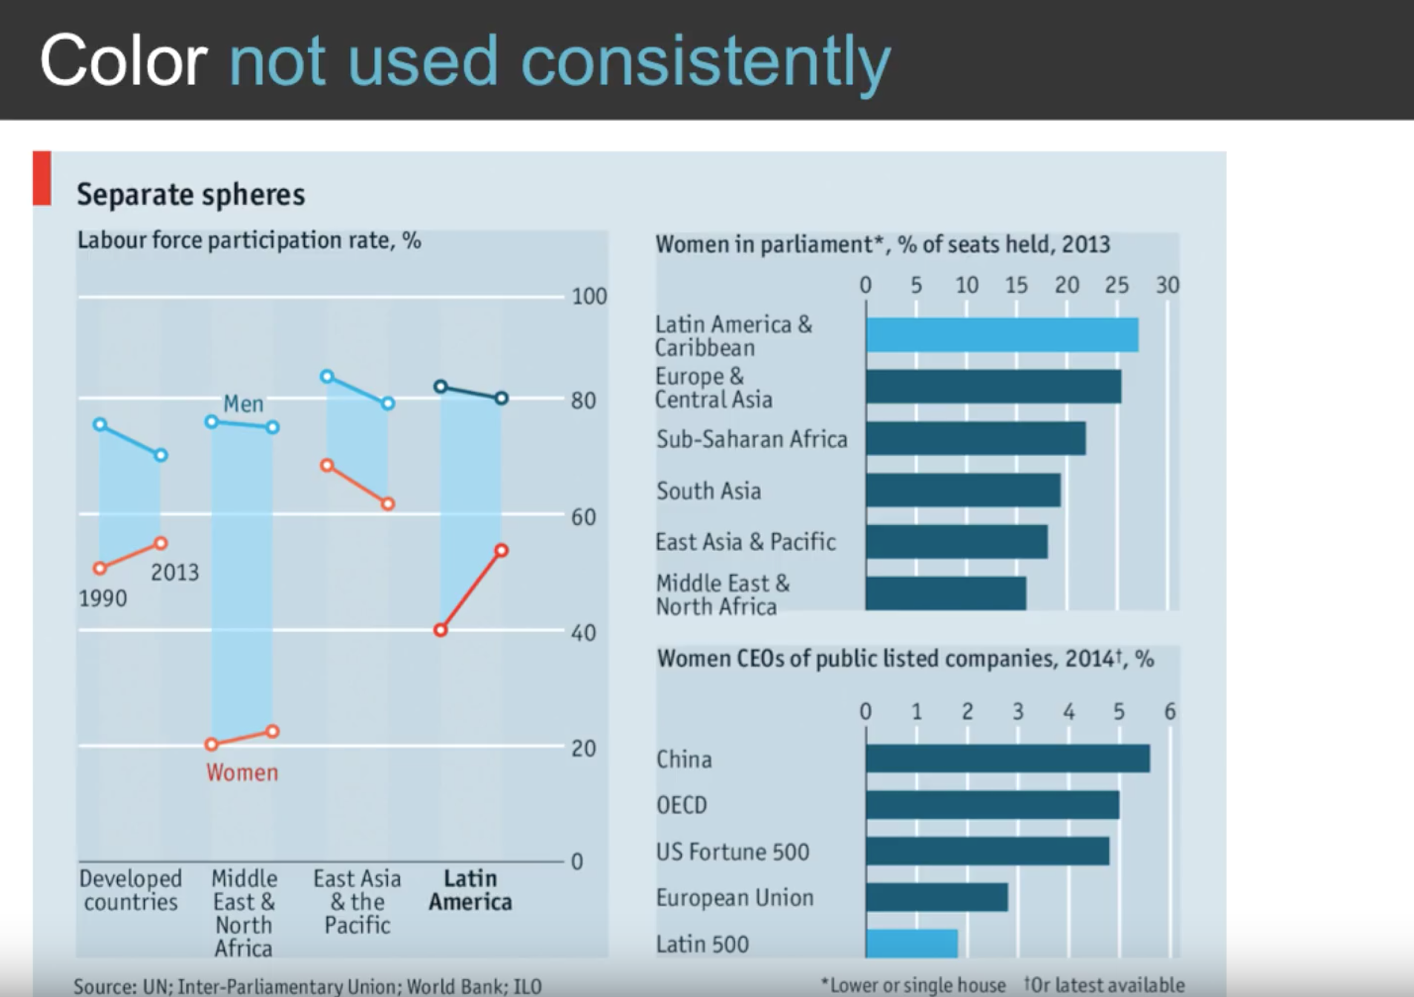
Notes:
This was in the Economist. Good graphs but can be made more effective…
Women were in red on left but not on right
Latin America was dark on left but bright on right?

Slide 37
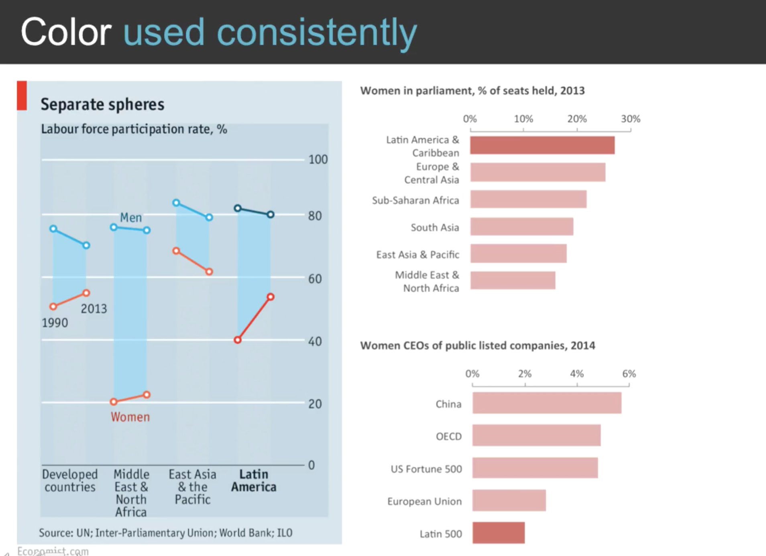

Slide 38
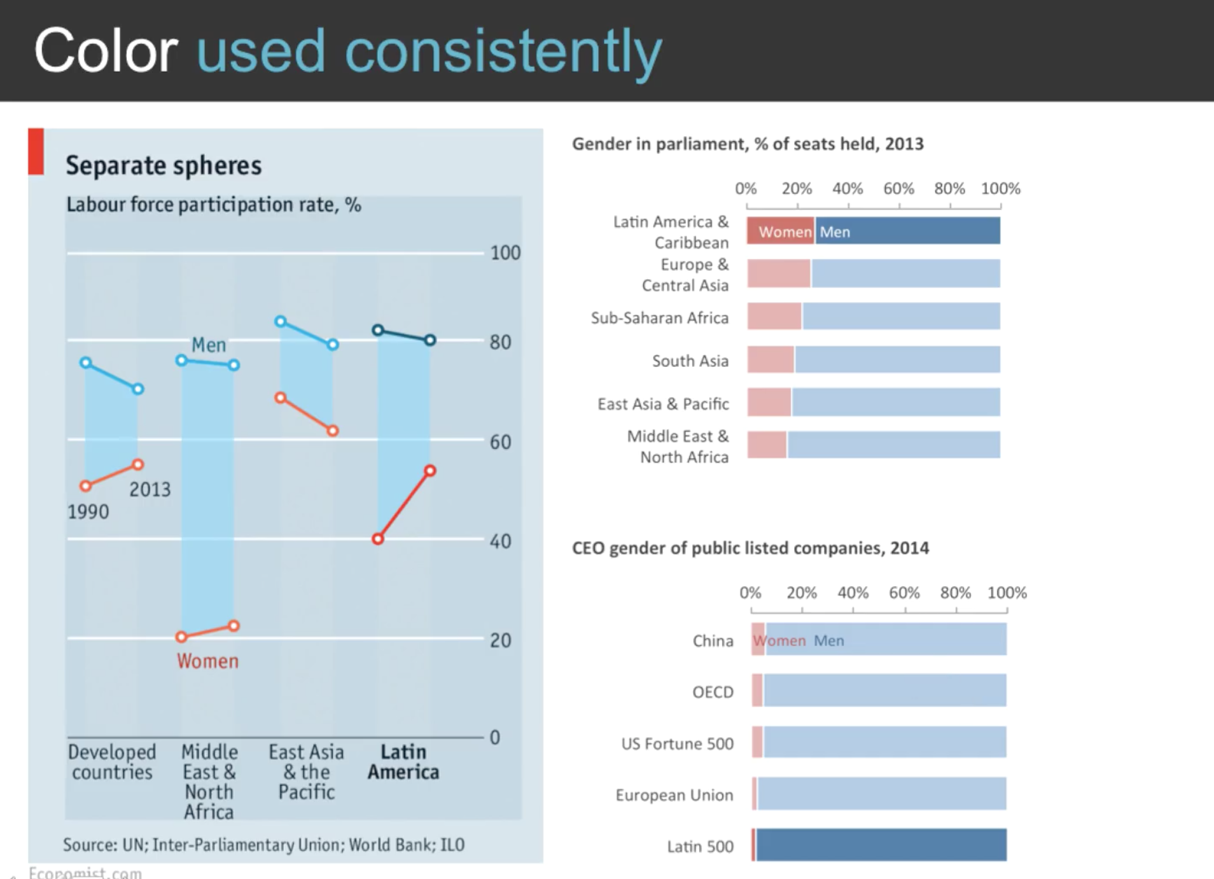

Slide 40
In more detail…

Slide 50
Notes:
Color is our brain's interpretation of our eyes' detection of the different wavelengths of visible light. This is the regime of light, with wavelengths between 400 nanometers and 700 nanometers (1 nanometer = 1 billionth of a meter = 10⁻⁹ meter), that our eyes are sensitive to. Our eyes have 3 ``color'' sensitive detectors called cones: red, green, and blue. Each type of cone is sensitive to a broad range in wavelength (called a response curve) of visible light, but this sensitivity is roughly bell-shaped, peaking at a particular wavelength, with lower sensitivity for wavelengths to either side of the peak. These response curves may be seen here. Our perception of color comes from the brain's interpretation of how many photons of particular wavelengths fall within the response curves of each of the 3 types of cones. For example, an equal mixture¹ of red and green light is interpreted as yellow, equal mixture of red and blue light is interpreted as magenta, and equal mixture of blue and green light is interpreted as cyan. Red, green, and blue are called primary colors; magenta, yellow, and cyan are called secondary colors. Our brain interprets a roughly equal mixture of red, green, and blue light (or a roughly equal mixture of secondary color light) as white light. Other ``colors'' are possible with the mixture of primary and/or secondary color light with white light. For example, pink is the combination of yellow and magenta light, or equivalently due to the combination of red and white light. It is probably more accurate to speak of degrees of response between the red, green&blue cones, rather than mixtures of red, green&blue light as I described above. Go here and here for more information. Further discussion of color rendering of spectra can be found here.

Slide 55
Notes:
In colorimetry, metamerism is a perceived matching of the colors with different (nonmatching) spectral power distributions. Colors that match this way are called metamers.

Slide 57
CIE Chromacity:
Explained better than I can!

Slide 107
Notes:
The Mixtec, languages belong to the Otomanguean language family of Mexico, and are closely related to the Trique and Cuicatec languages. They are spoken by over half a million people.
Tlapanec is an indigenous Mexican language spoken by more than 98,000 Tlapanec people in the state of Guerrero. Like other Oto-Manguean languages, it is tonal and has complex inflectional morphology.

Slide 108
Notes:
Camsa – Columbia regien
Chavacano or Chabacano refers to a number of Spanish-based creole language varieties spoken in the Philippines.

Slide 121
Notes:
Frequency allocation (or spectrum allocation) is the division of the electromagnetic spectrum into radiofrequency bands. ... Radio propagation does not stop at national boundaries. Giving technical and economic reasons, governments have sought to harmonise the allocation of RF bands and their standardization.

Slide 123
Notes:
Our ability to reliably name colors provides a link between visual perception and symbolic cognition. In this project, we investigate how a statistical model of color naming can enable user interfaces to meaningfully mimic this link and support enhanced interactions.
We construct a probabilistic model of color naming from a large, unconstrained set of human color name judgments. This model can be used to map between colors and names and to define metrics for color saliency (how reliably a color is named) and color name distance (the similarity between colors based on naming patterns).
This model can enable enhanced user interfaces. Demo applications linked below include a color dictionary&thesaurus, evaluation aids for color palette design and name-based pixel selection methods for image editing.
sa·li·ence
ˈsālēəns/
noun
the quality of being particularly noticeable or important; prominence.

